Slide 1
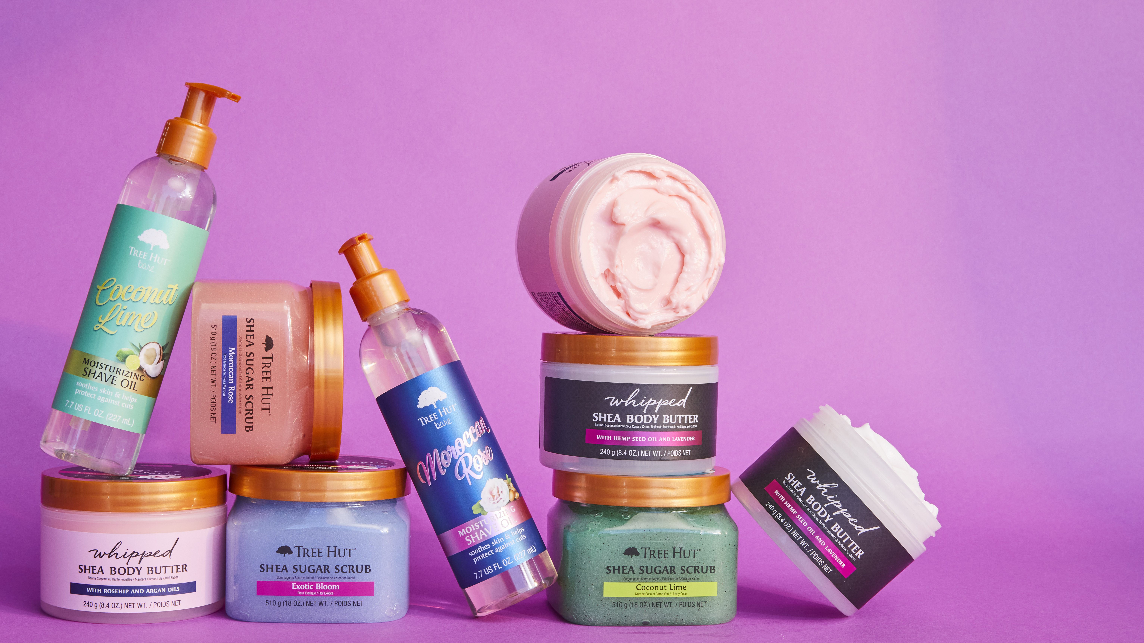

2023 New Products
Notes:
Scrub butter collection

Slide 2
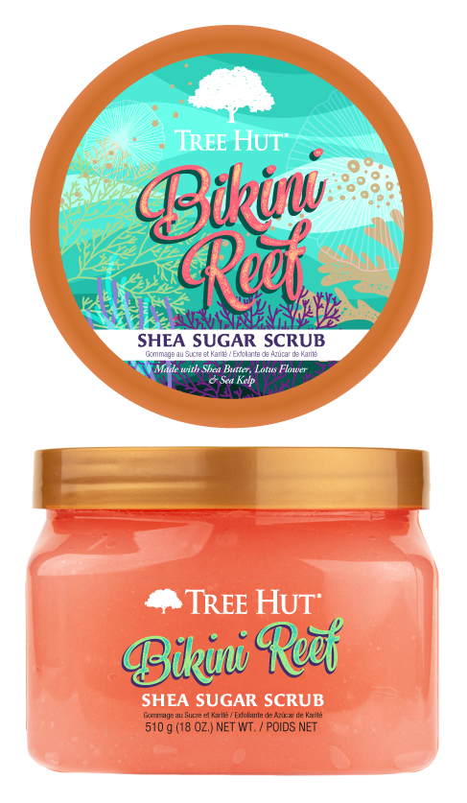

Shea Sugar Scrub: Destination
Bikini Reef Sugar Scrub​
Treat skin to a sweet escape with Bikini Reef Shea Sugar Scrub. Notes of pink sugar and hibiscus take your senses on tropical vacation while lotus flower and sea kelp help improve look and feel of dry skin.
Benefits
LOTUS FLOWER is a natural antibacterial that contains skin balancing properties and helps improve the look and feel of dry skin.
SEA KELP contains vitamins, minerals, antioxidants and essential fatty acids that hydrate and nourish skin. It is known to provide anti-aging and anti-inflammatory benefits.​
SHEA BUTTER is known to deeply moisturize, nourish and soften skin while helping to promote elasticity.
Scent Profile
TOP:
Orange Blossom Apple
Berry
Hibiscus
MIDDLE:
Coconut Water
Pink Sugar
Watermelon
BOTTOM:
Vanilla
Amber
Sandalwood
700296
CONFIDENTIAL INFORMATION |

Slide 3
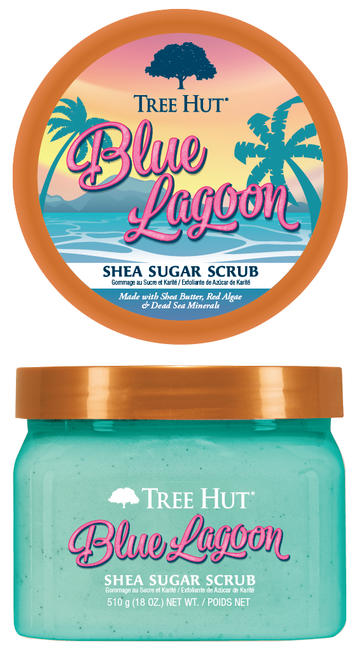

Shea Sugar Scrub: Destination
Blue Lagoon Sugar Scrub​
Red algae and dead sea minerals bring oceanic benefits to your skin in Blue Lagoon Shea Sugar Scrub. An aquatic fragrance of seaweed, orange and lily. Marine ingredients help regenerate and stimulate skin.
Benefits
RED ALGAE is known for its anti-aging benefits. Red algae helps to nourish, hydrate, and improve skin elasticity.
​
DEAD SEA MINERALS stimulate the skin, promote skin regeneration, and help regulate skin functions.
SHEA BUTTER is known to deeply moisturize, nourish and soften skin while helping to promote elasticity.
Scent Profile
TOP:
Cactus Water
Seaweed
Orange
MIDDLE:
Lily
Honey
Melon
Jasmine
BOTTOM:
Green Moss
Amber
Sandalwood
700291
CONFIDENTIAL INFORMATION |

Slide 4
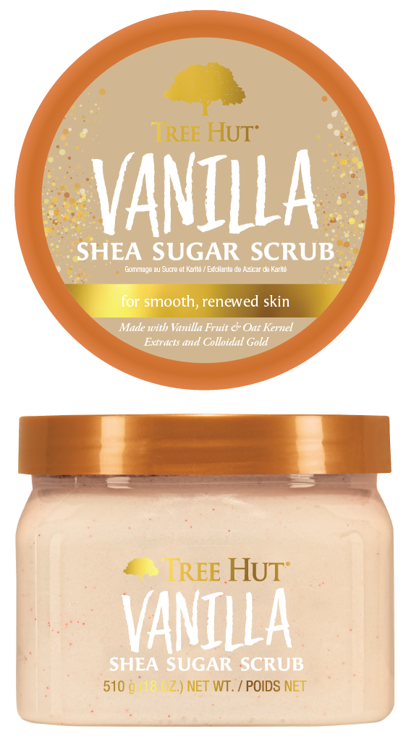

Shea Sugar Scrub: Solution
Vanilla Sugar Scrub
Shimmer and shine with Tree Hut’s Vanilla Shea Sugar Scrub. Packed with real vanilla extract to soothe skin and colloidal gold, known to increase skin elasticity, this shimmering scrub will have you glowing from head to toe.
Benefits
COLLOIDAL GOLD is known to plump skin and promote improved skin elasticity. Its small size allows gold to penetrate skin effectively for a lifting effect.
VANILLA contains antioxidant properties and is known to hydrate skin.
SHEA BUTTER is known to deeply moisturize, nourish and soften skin while helping to promote elasticity.
Scent Profile
TOP:
Sheer Jasmine
MIDDLE:
Coconut Cream
BOTTOM:
Vanilla
Musk
Sandalwood
700294
CONFIDENTIAL INFORMATION |

Slide 5
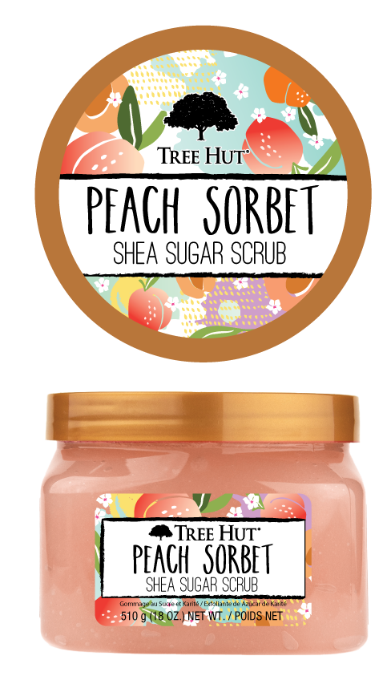

Shea Sugar Scrub: Sweet
Peach Sorbet Sugar Scrub​
Relax and give your skin a pick-me-up with Peach Sorbet Shea Sugar Scrub. A blend of sun-kissed apricot and peach blossom make for the perfect peach scent. Apricot kernel oil and peach help lock in moisture and boost skin radiance.
Benefits
APRICOT KERNEL OIL helps soften skin and lock in moisture. It is known to help improve skin tone and promote a strong skin barrier.
PEACH EXTRACT helps balance skin and boost radiance. It helps protect skin from environmental stressors and assists in increasing skin cell turnover.
SHEA BUTTER is known to deeply moisturize, nourish and soften skin while helping to promote elasticity.
Scent Profile
TOP: ​
Sunkissed Apricot ​
Red Grapefruit​
Strawberry Leaves ​
Ripe Melon​
Banana Flower
MIDDLE: ​
Peach Blossom ​
Apple Nectar ​
Jasmine​
Rose​
Lily​
Night Violet
BOTTOM:
Coconut Flakes
Warm Musk
700298
CONFIDENTIAL INFORMATION |

Slide 6
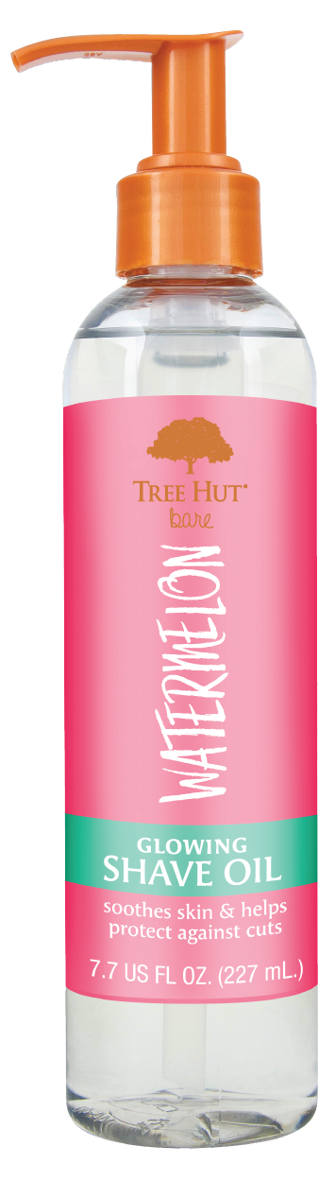
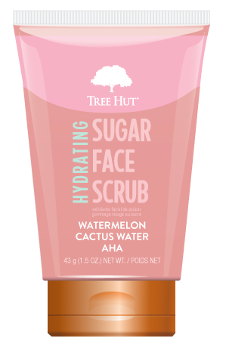
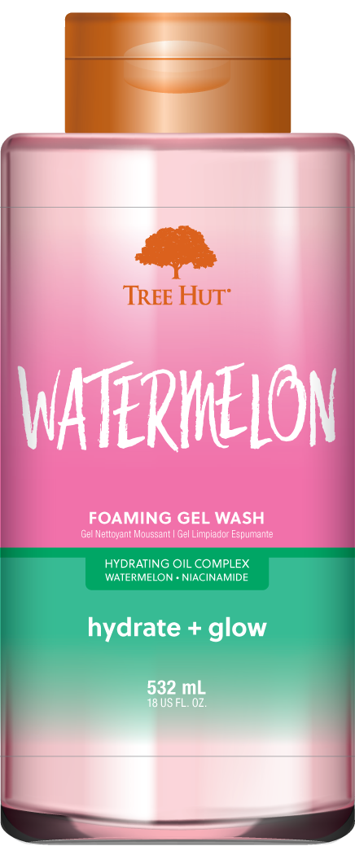
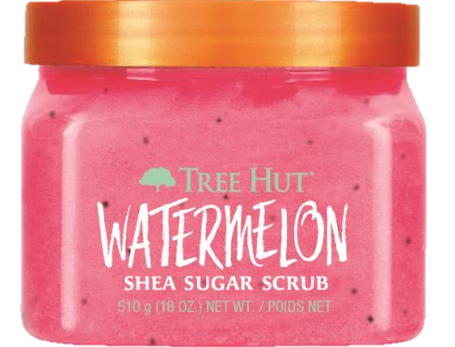
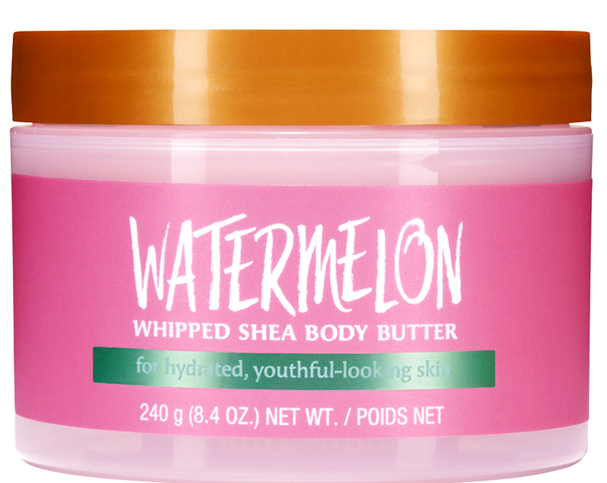
Regimen Builder
cleanse
exfoliate
shave
hydrate
face
Clear your skin of dirt while balancing its microbiome. Contains gentle surfactants that remove excess oil and grime to reset skin’s foundational routine.
Exfoliate your body to reveal super soft skin:
Promises a close, effective shave with minimal post-shave irritation like bumps, and ingrown hairs.
Replenish and seal in moisture for a lasting glow with this non-greasy lightweight hydrator!
Hydrate, glow and smooth tired-looking skin to reveal a refreshed, radiant complexion
removes dry skin
soften & lift the hair follicle and prep the skin for a silky smooth and close shave!
Infused with hydrating oils that leave the skin feeling soft and supple.
1
2
3
4
5
CONFIDENTIAL INFORMATION |

Slide 7
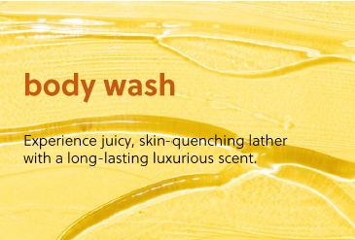
Foaming Gel Wash

Slide 8
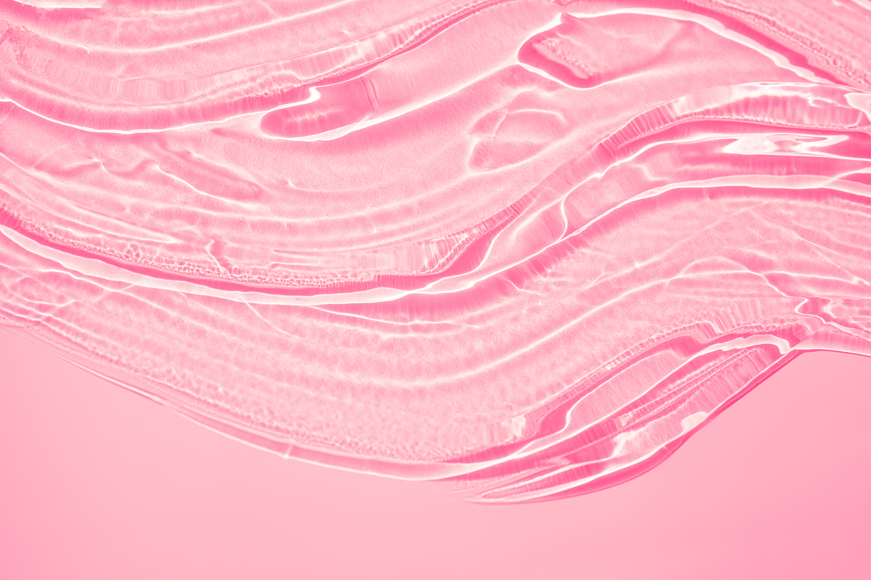
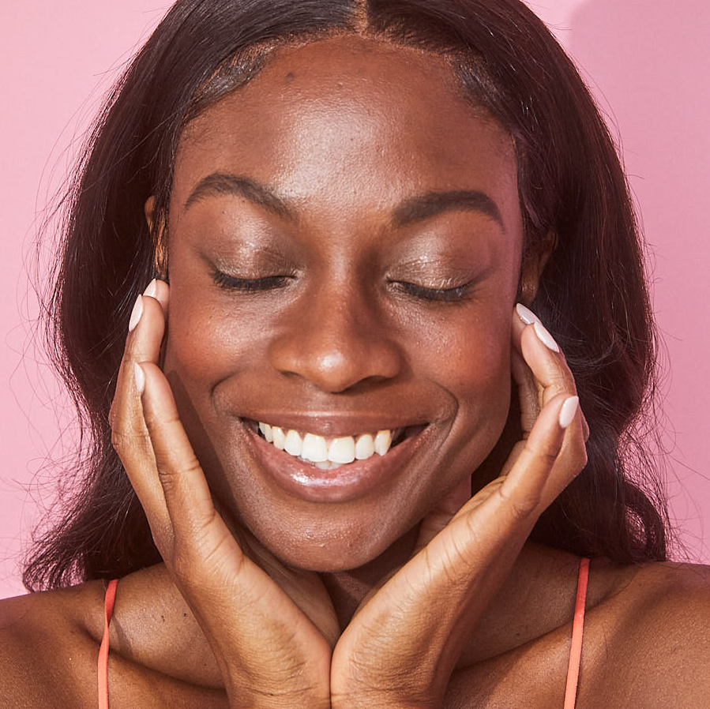
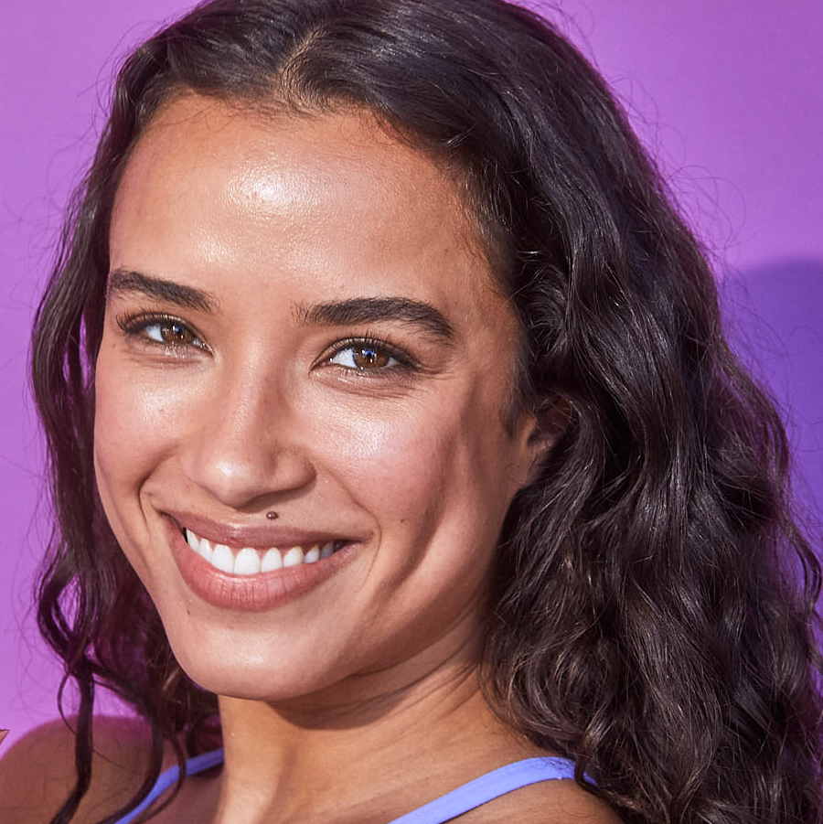
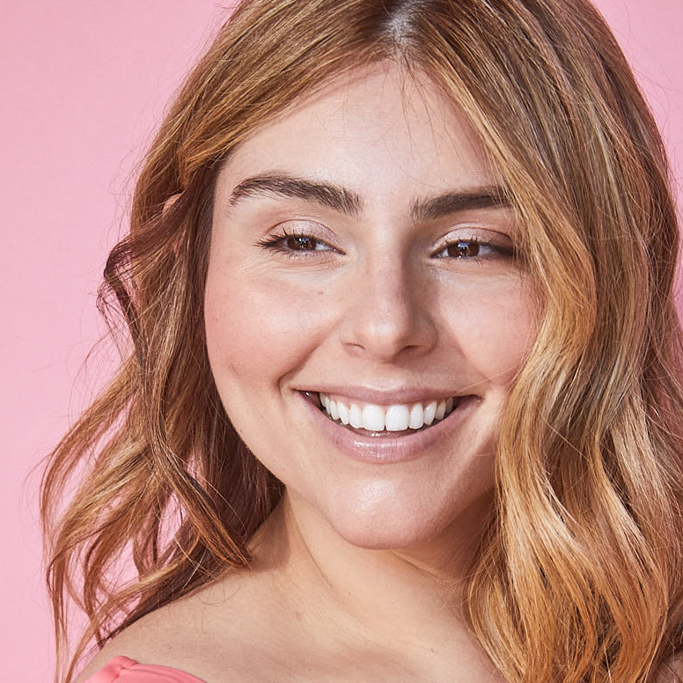
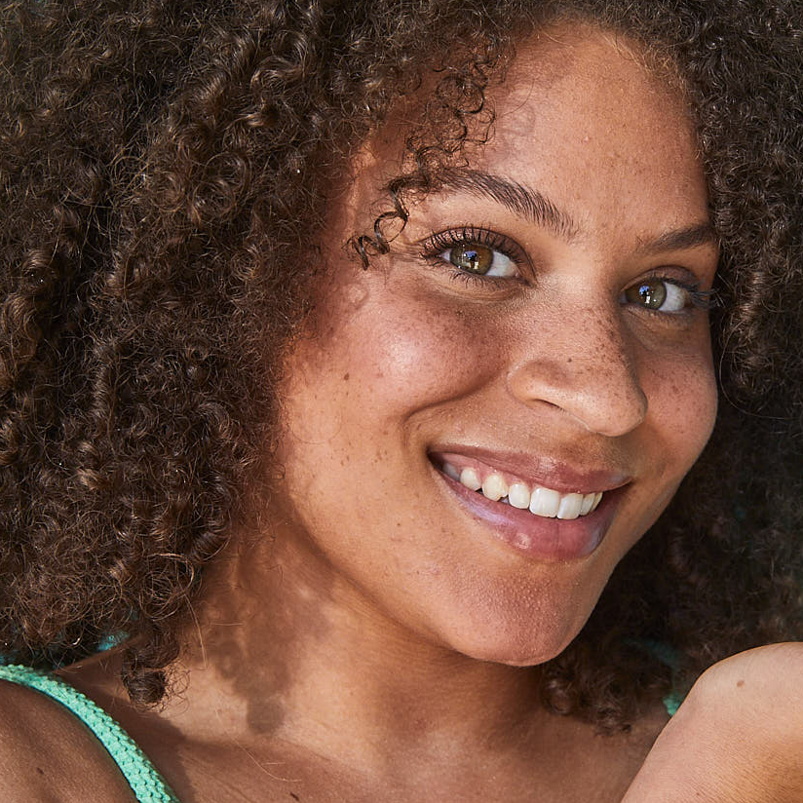
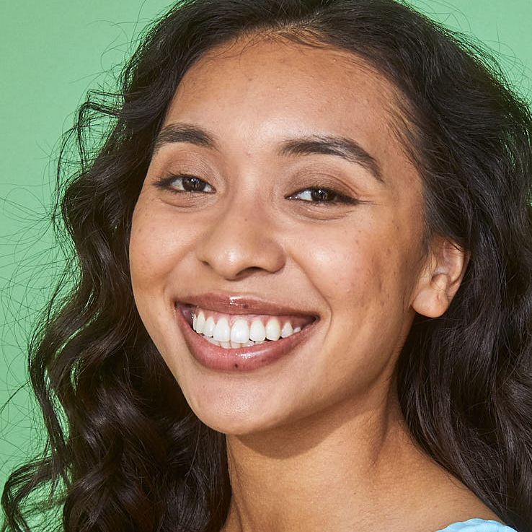
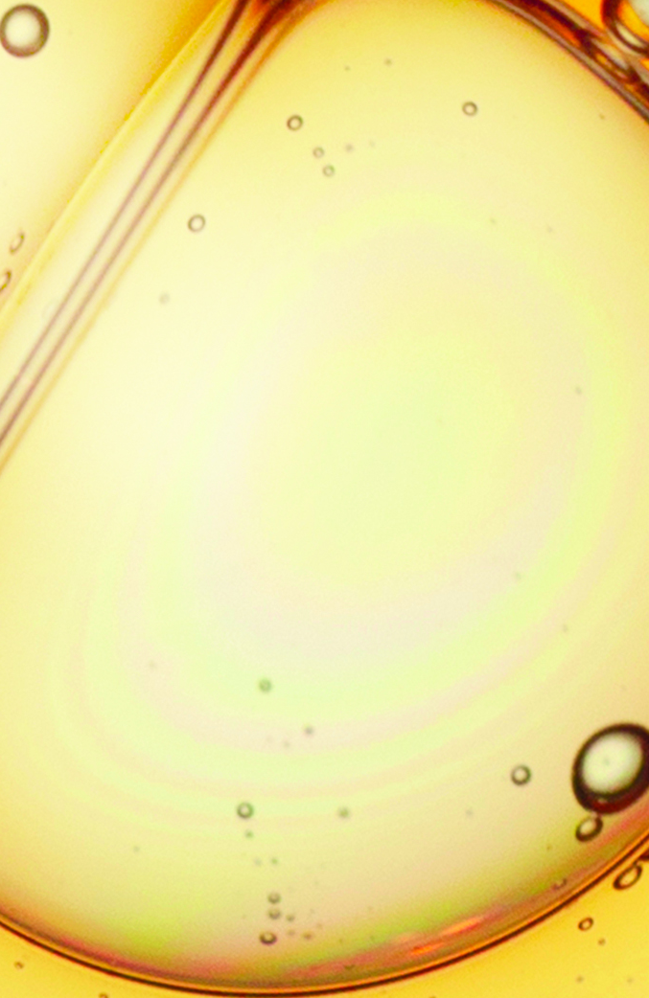
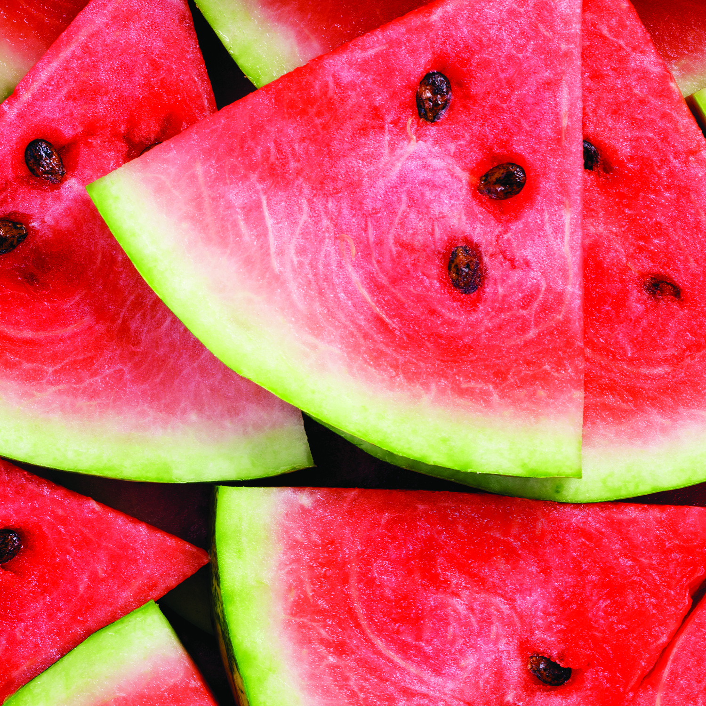
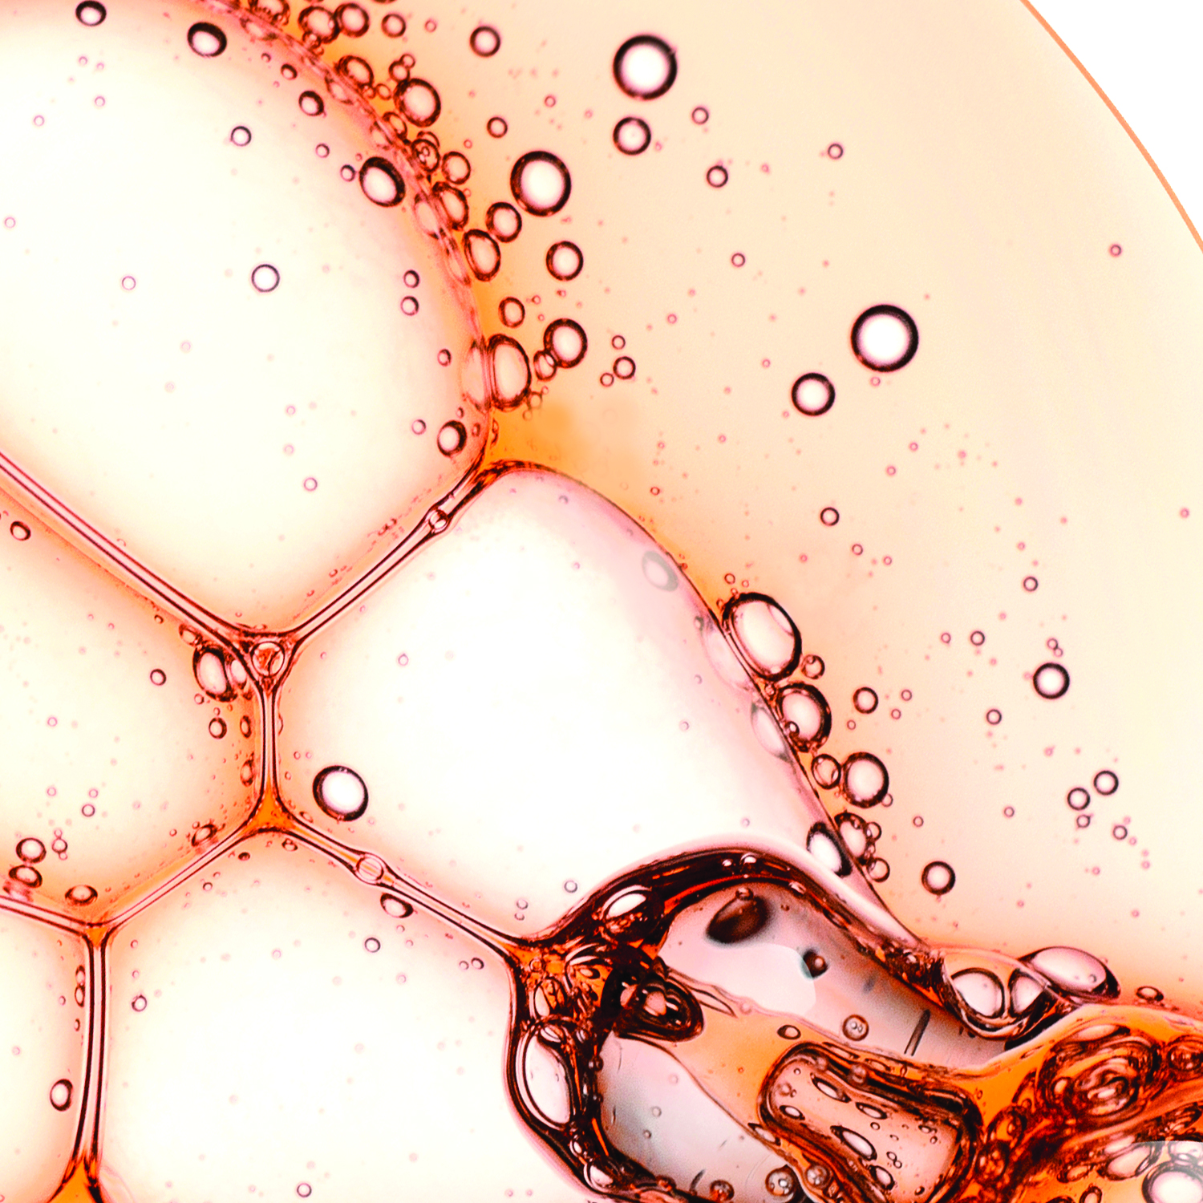
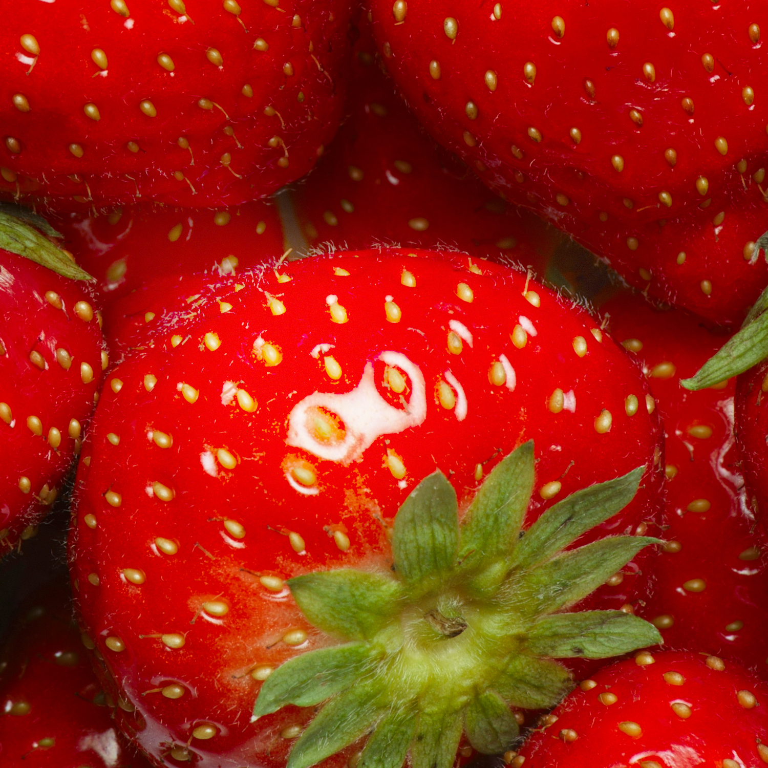
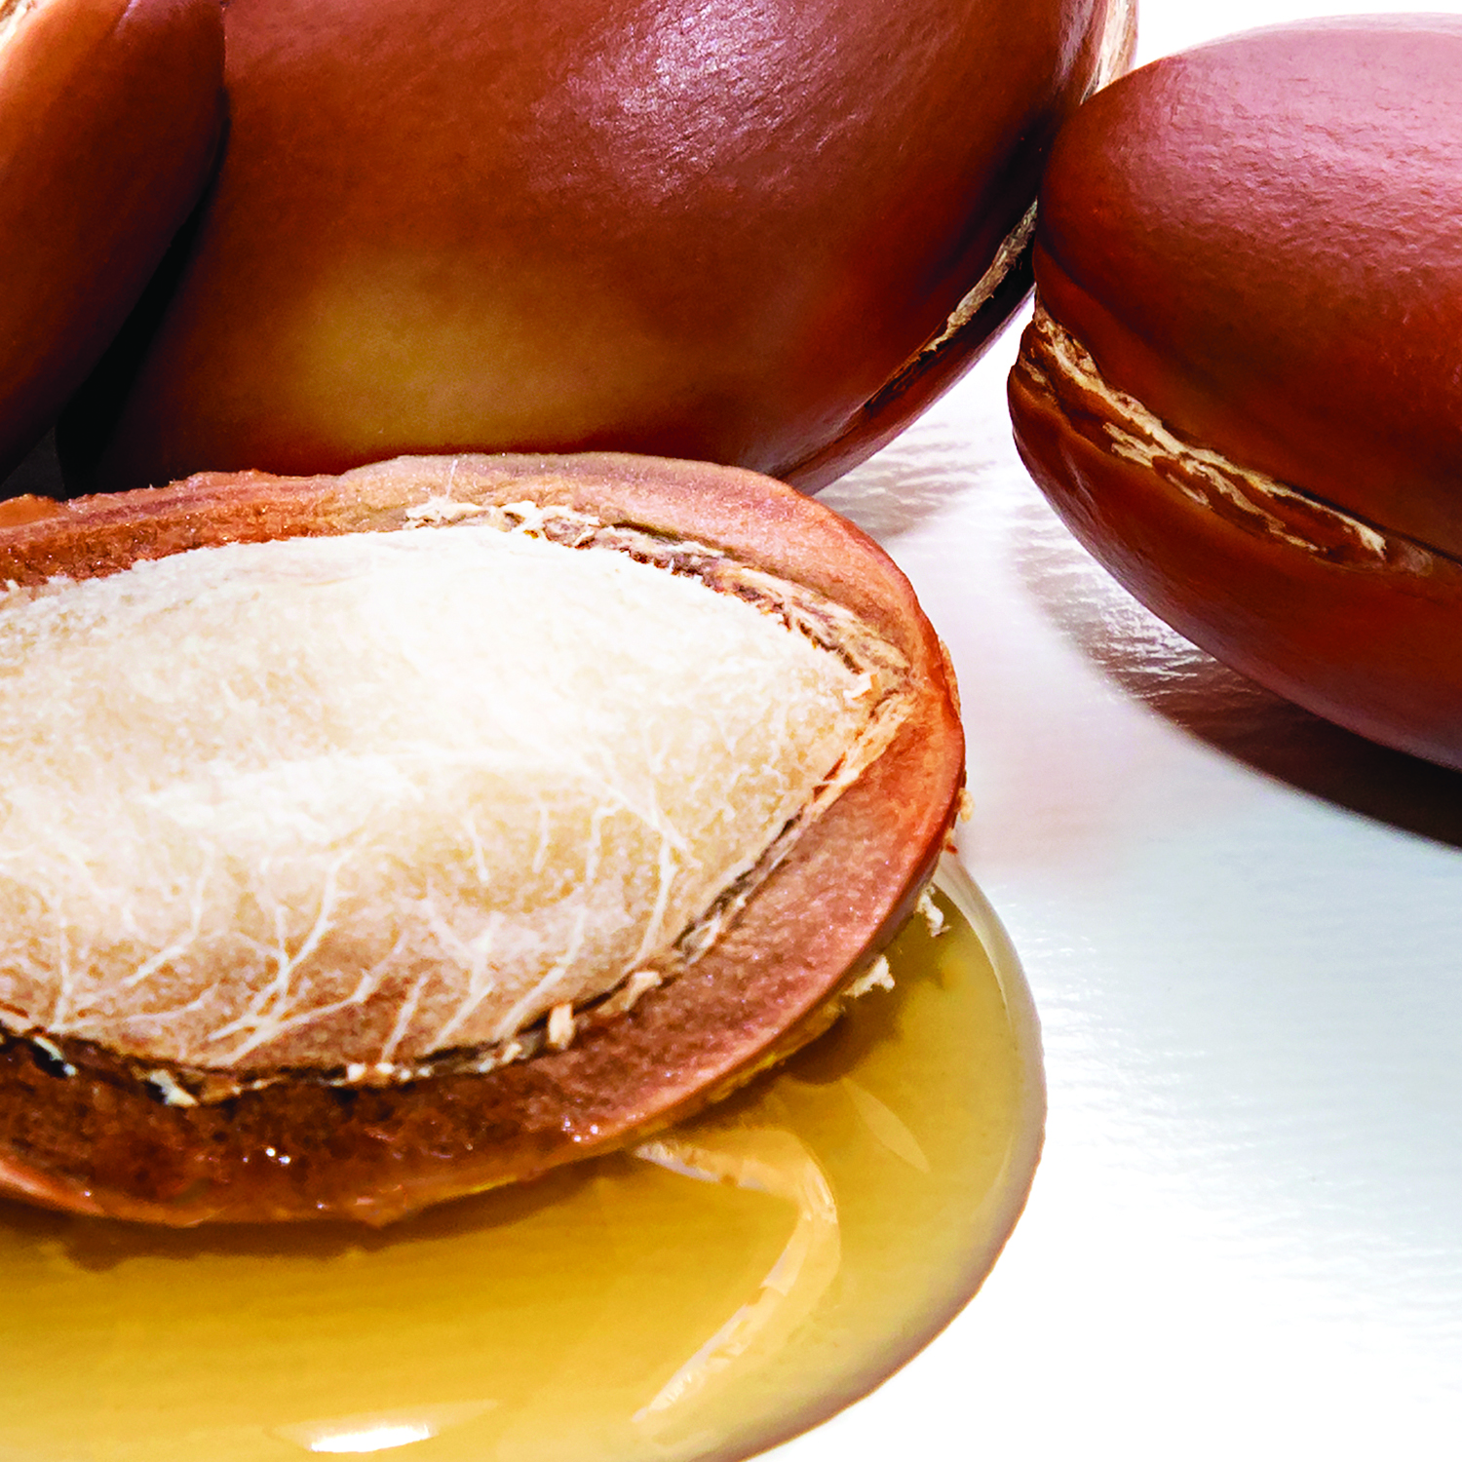
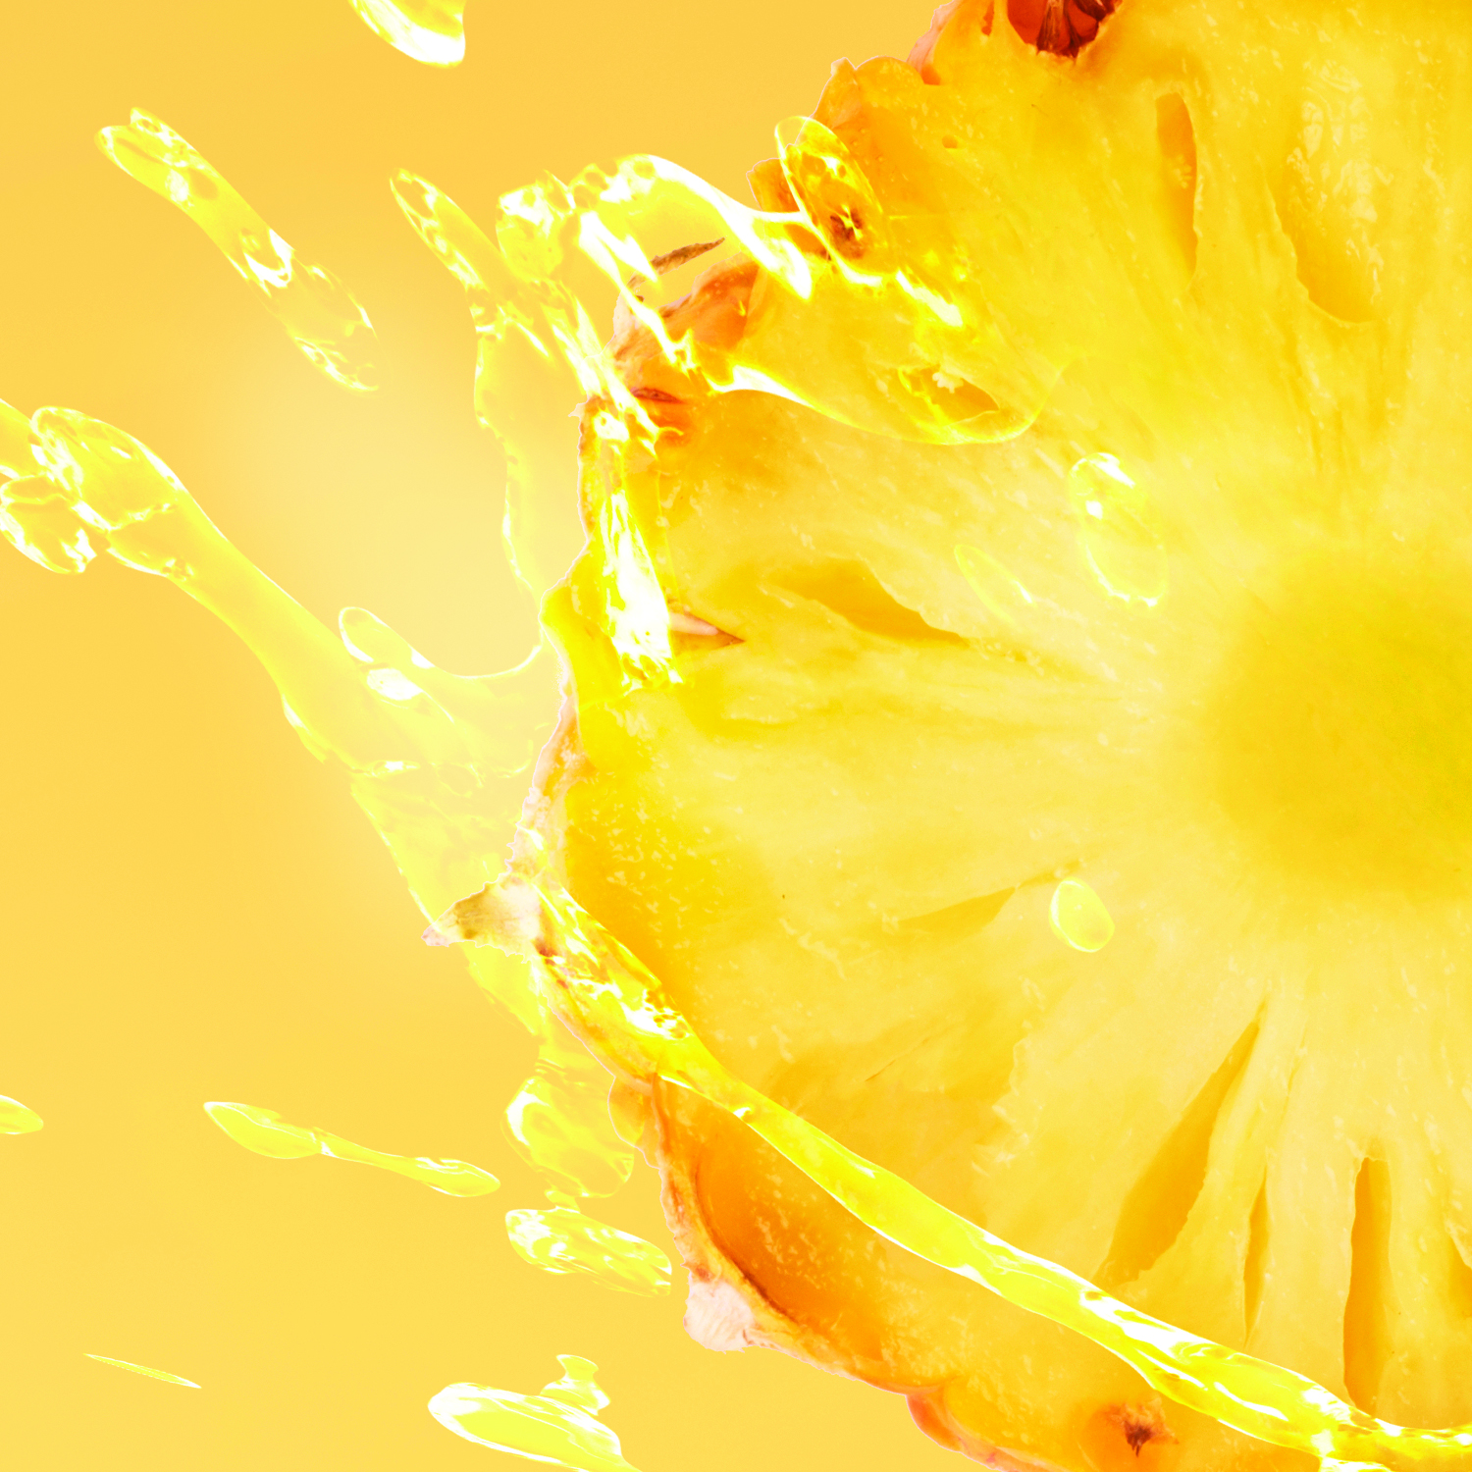
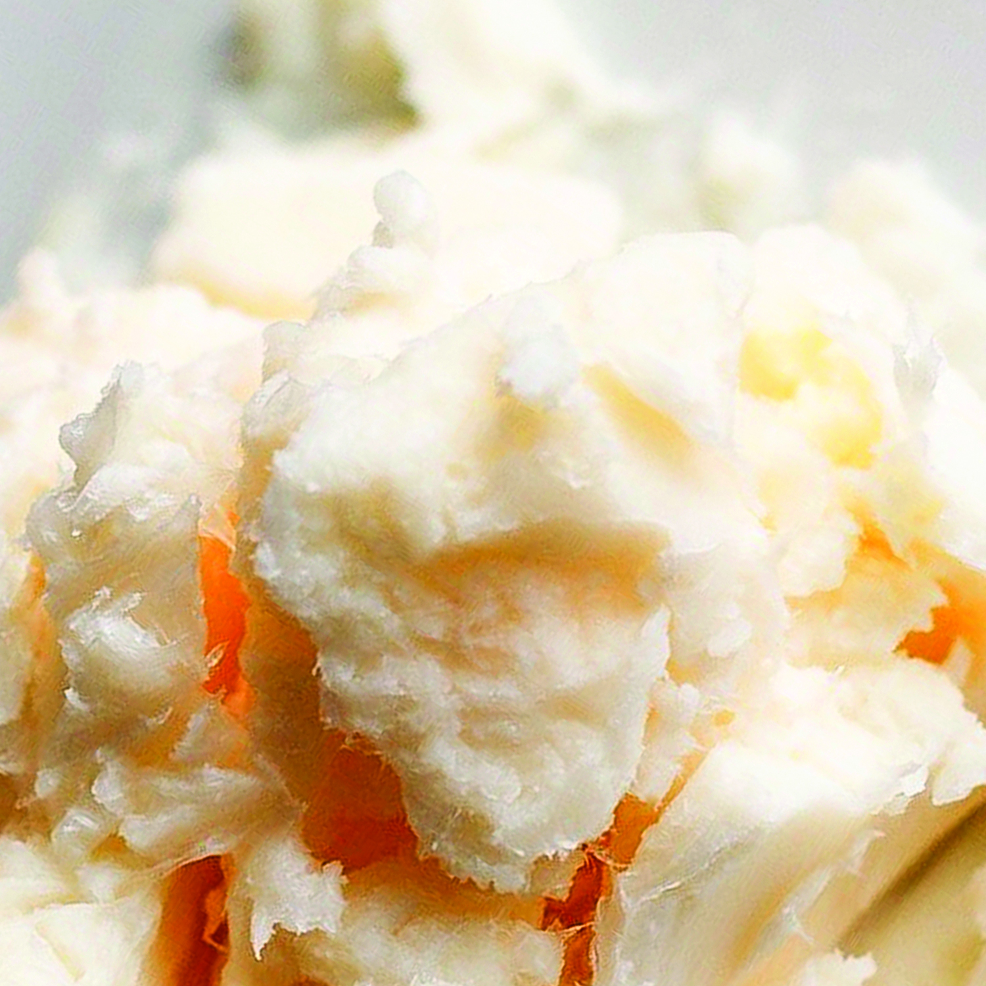
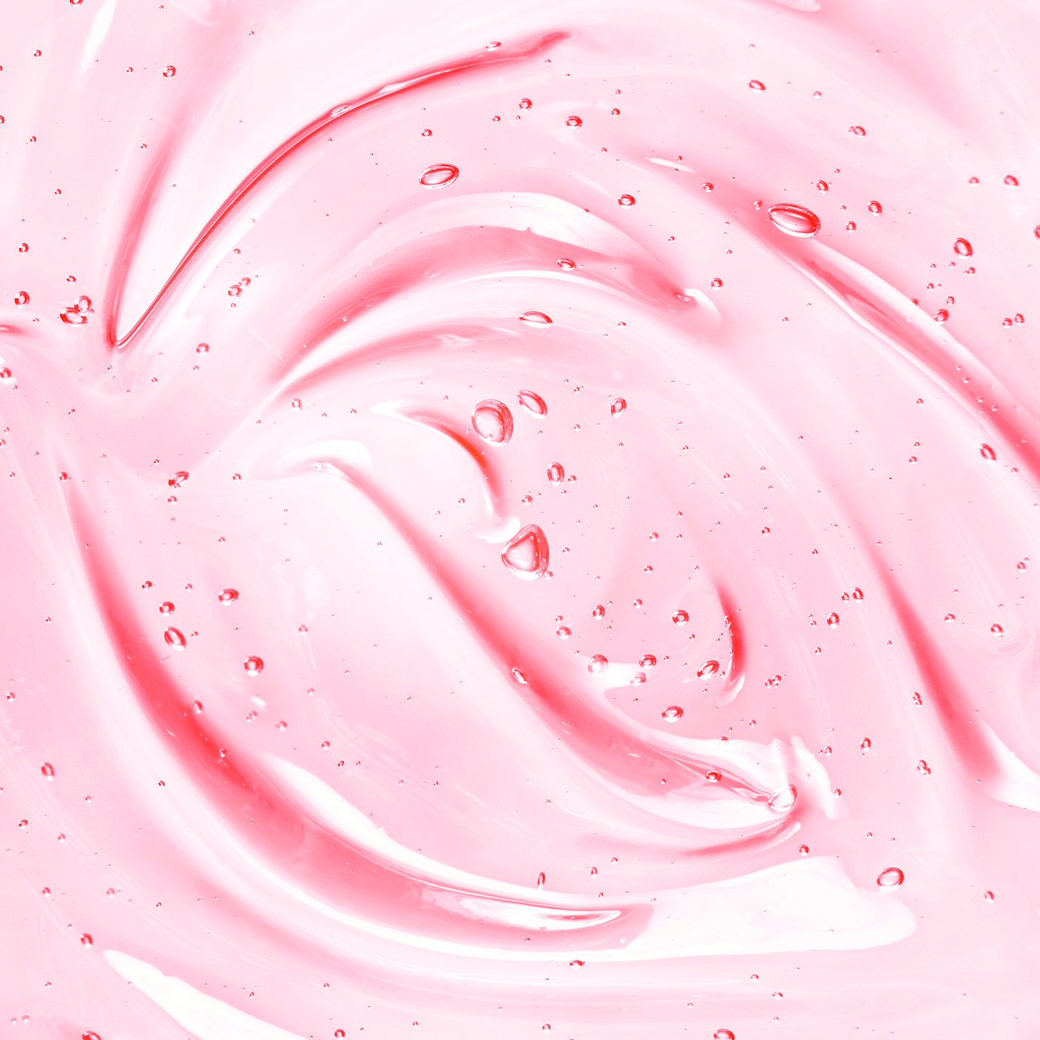
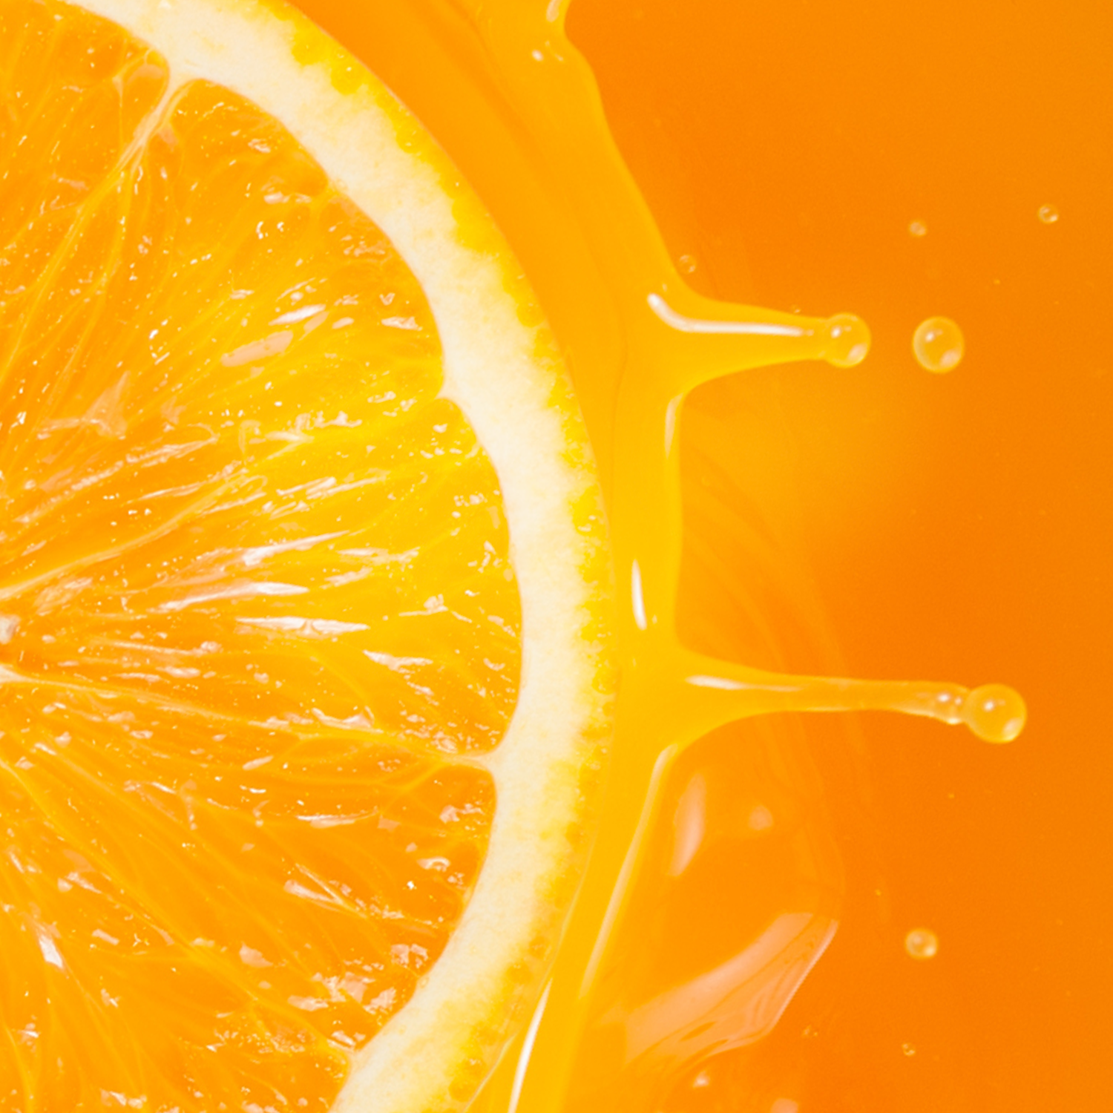
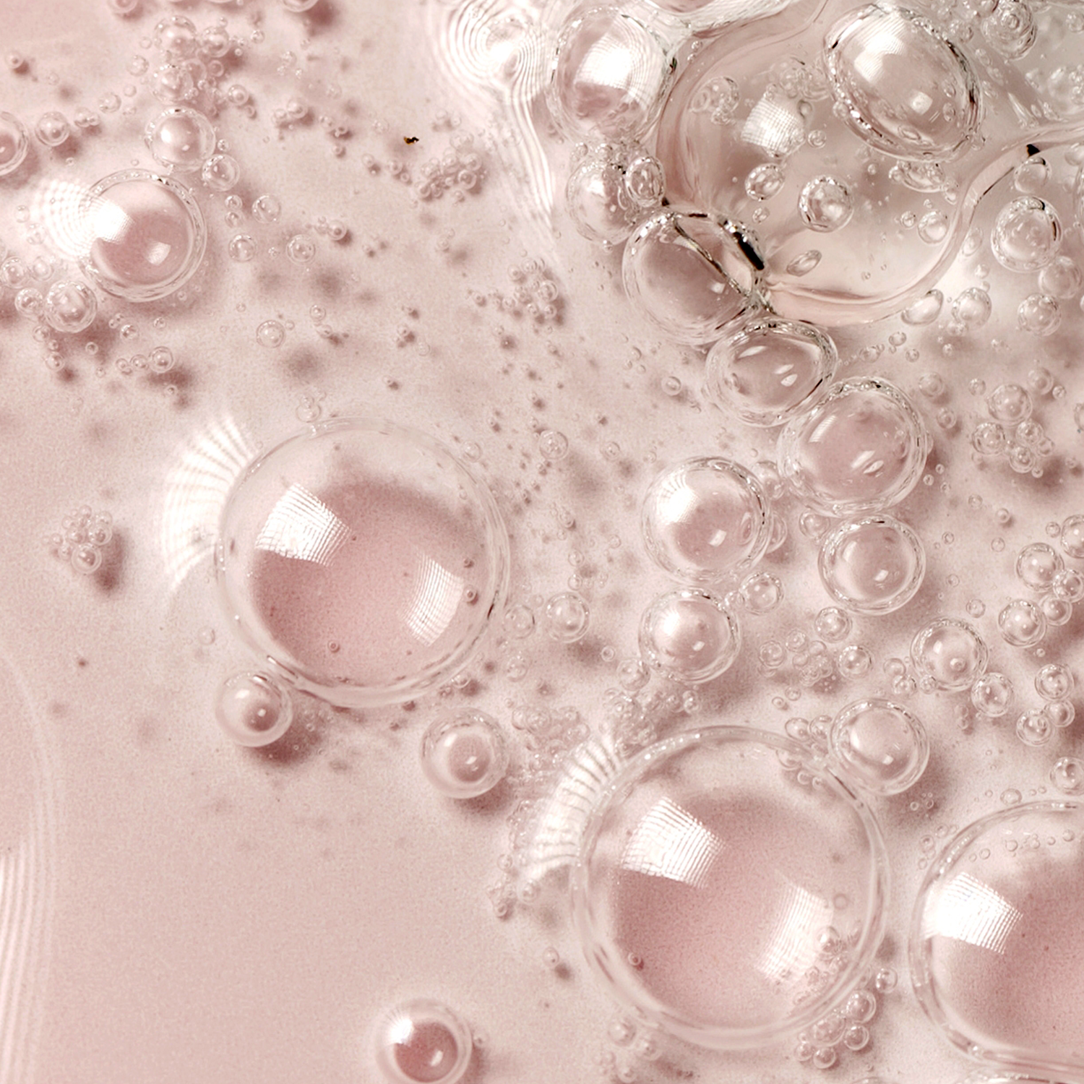
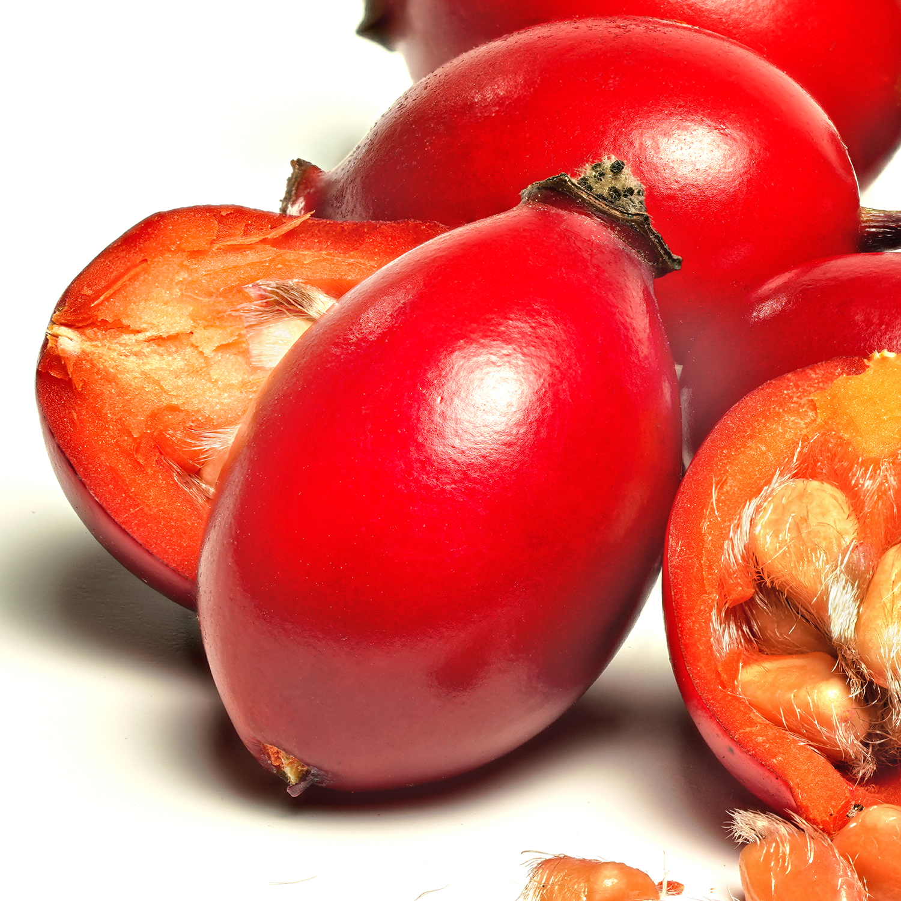
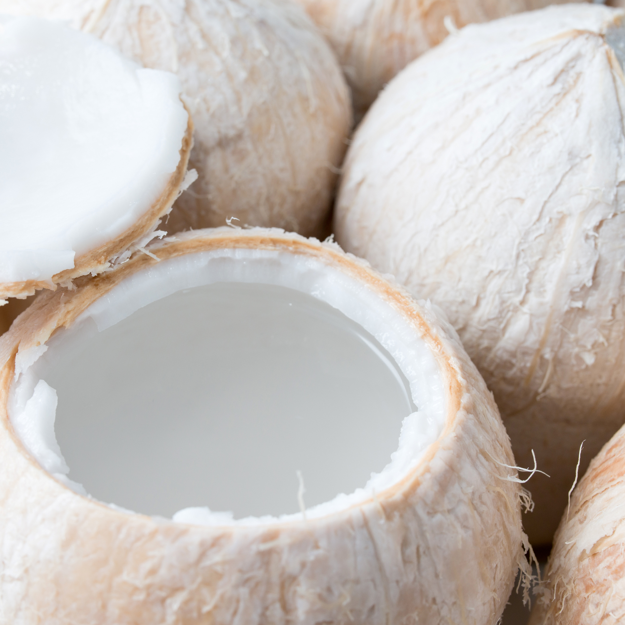
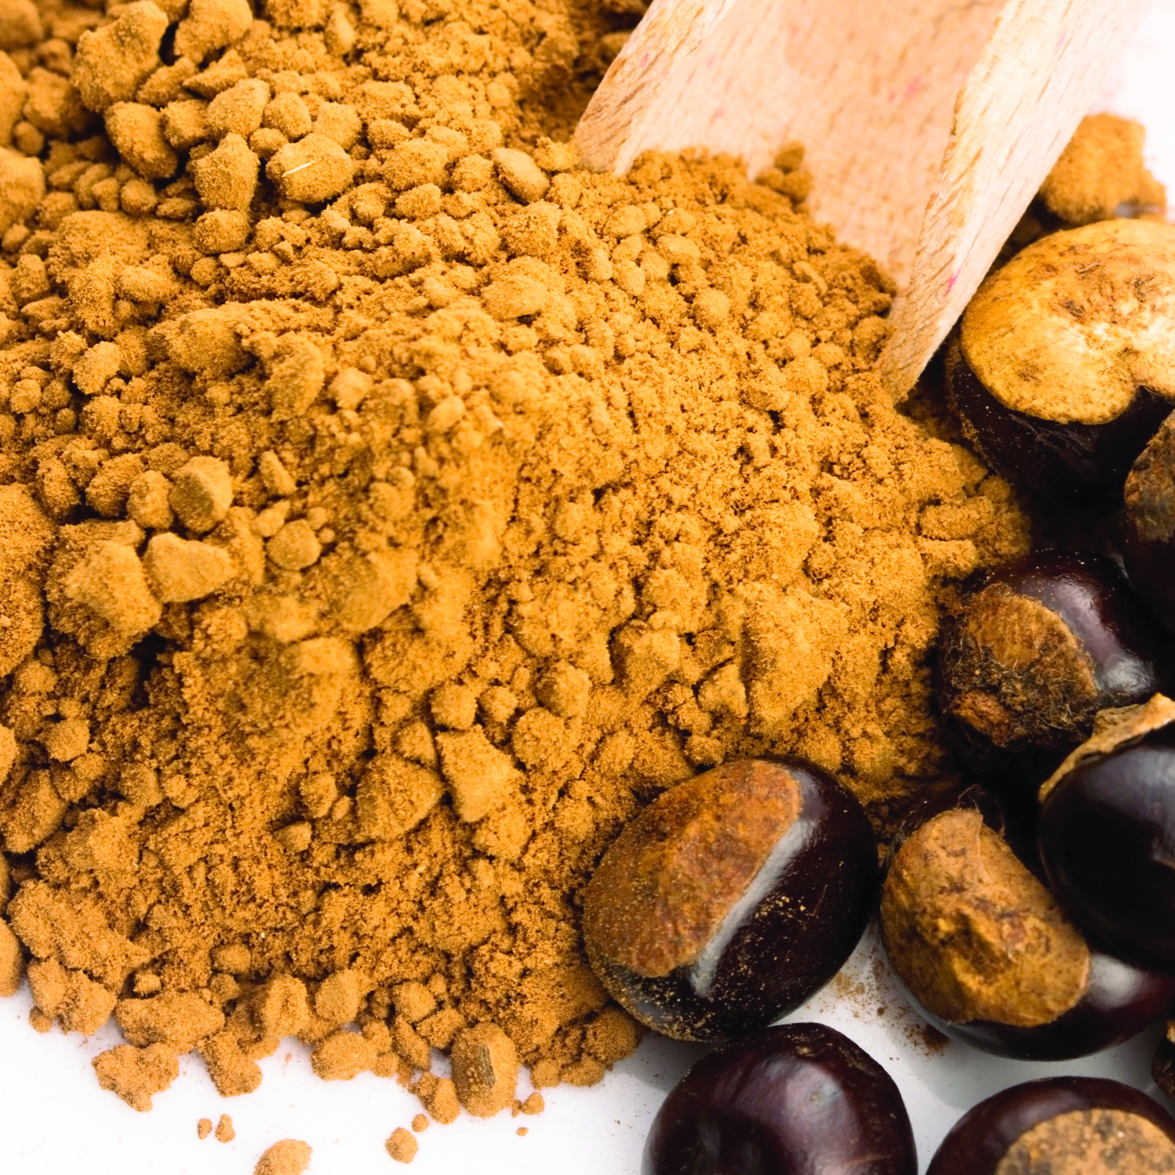







NEW! Foaming Gel Wash
Made for:
Experience juicy, skin-quenching lather with a long-lasting luxurious scent
Made for all skin types
Consumer Interest
67%
Seek Mood-Boosting Products
69%
Desire Products with a Long-lasting Fragrance
70%
Want Body Products with Skincare Ingredients
Made with
A special hydrating oil complex to plump skin with renewing antioxidants, brightening vitamin C and nourishing rich fatty acids.
Scent-specific Hero Ingredients add an extra boost of skin-soaking nourishment
CLEANSES
HYDRATES
NOURISHES
BRIGHTENS
PARABEN
FREE
NO FORMALDEHYDE DONORS
SULFATE
FREE
The
Result:
Skin’s microbiome feels soft and refreshed
Lingering scent on skin, perfect for scent-layering with full regimen.
Skin appears balanced, healthy-looking and glowing
Base: 1,989 internet users aged 18+ who use soap, bath and shower products
Source: Kantar/Mintel November 2021
CONFIDENTIAL INFORMATION |

Slide 9

Body Wash: Solutions
≠≠≠
Watermelon Body Wash
Indulge in the luxurious smell of juicy watermelon while exfoliating and toning your skin with watermelon extract and niacinamide.
Benefits
WATERMELON is rich in vitamins and antioxidants known to help protect damaged skin and help with anti-aging.
NIACINAMIDE is known to reduce inflammation and minimize the appearance of pores.
Scent Profile
TOP:
Meyer Lemon Zest, Sparling Water, Green Apple, Pineapple
MIDDLE:
White Pear, Jasmine Petals, Violet
BOTTOM:
Raspberry Cotton Candy, Caramelized Vanilla
725070
CONFIDENTIAL INFORMATION |

Slide 10
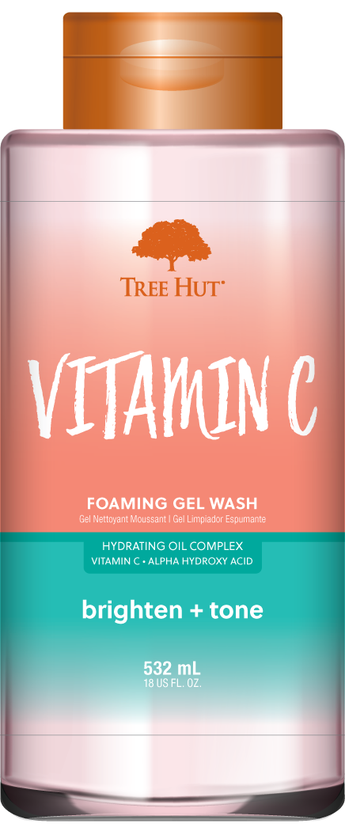

Body Wash: Solutions
Vitamin C Body Wash
Kick off your self-care routine with juicy Vitamin C Foaming Jelly Wash. The wash is packed with AHAs and vitamin C for clearer, brighter skin. With notes of juicy pink grapefruit, lemon and orange, this wash is sure to brighten your self-care routine.
Benefits
VITAMIN C is known to promote collagen production and diminish fine lines for youthful and glowing skin.
AHAs are super skin smoothers; known to contain water soluble acids that help to gently slough away dead skin cells. AHAs are the perfect addition to your bodycare routine.
Scent Profile
TOP:
Lemon, Pink Grapefruit, Orange
MIDDLE:
Apple, Cyclamen, Jasmine
BOTTOM:
Amber, Musk, Peach Nectar
725077
CONFIDENTIAL INFORMATION |

Slide 11
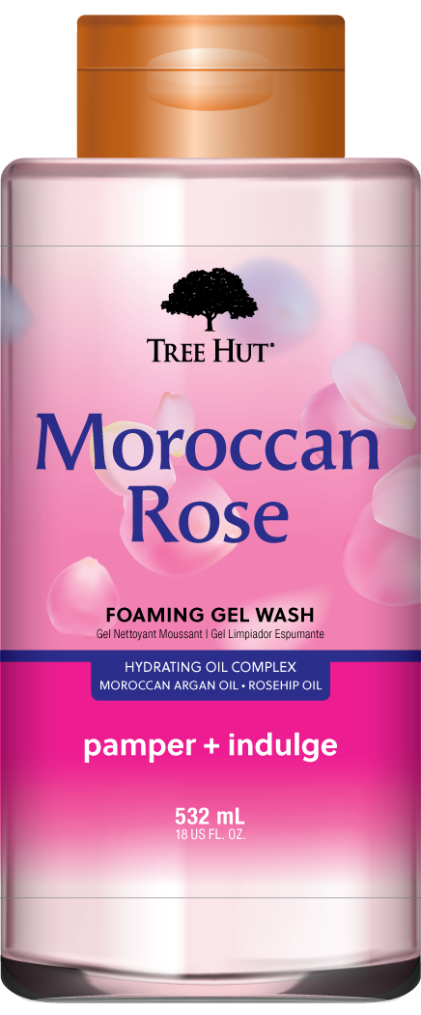

Body Wash: Classic
Moroccan Rose Body Wash
Elevate your shower routine with the luxurious smell of Moroccan Rose. With Moroccan Argan Oil and Rose Hip Oil, this wash will leave you feeling pampered and refreshed.
Benefits
MOROCCAN ARGAN OIL helps to balance skin, improve elasticity, and help hydrate dry skin with lipids, fatty acids and vitamin E.
ROSEHIP OIL is known to help visibly refine skin’s texture and promote a radiant glow.
Scent Profile
TOP:
Lemon, Ozone, Bergamot
MIDDLE:
Tea Rose, Muget, Jasmine, lily
BOTTOM:
Amber, Melon, Vanilla
725075
CONFIDENTIAL INFORMATION |

Slide 12
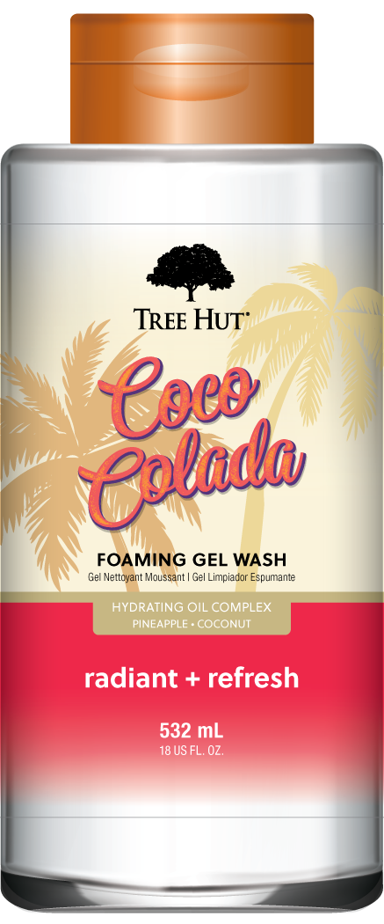

Body Wash: Destination
Coco Colada Body Wash
Kick off your self care routine with the fresh and tropical scent of Coco Colada. This tropical wash is packed with coconut and pineapple extracts known to leave skin feeling radiant and refreshed.
Benefits
PINEAPPLE features skin-loving vitamin C, known to help brighten and even skin tone appearance.
COCONUT is known to help moisturize and soften skin.
Scent Profile
TOP:
Coconut,
Pineapple
MIDDLE:
Guava, White Orchid
BOTTOM:
Coconut Milk, Musk
725073
CONFIDENTIAL INFORMATION |

Slide 13
Fall 2023

Slide 14
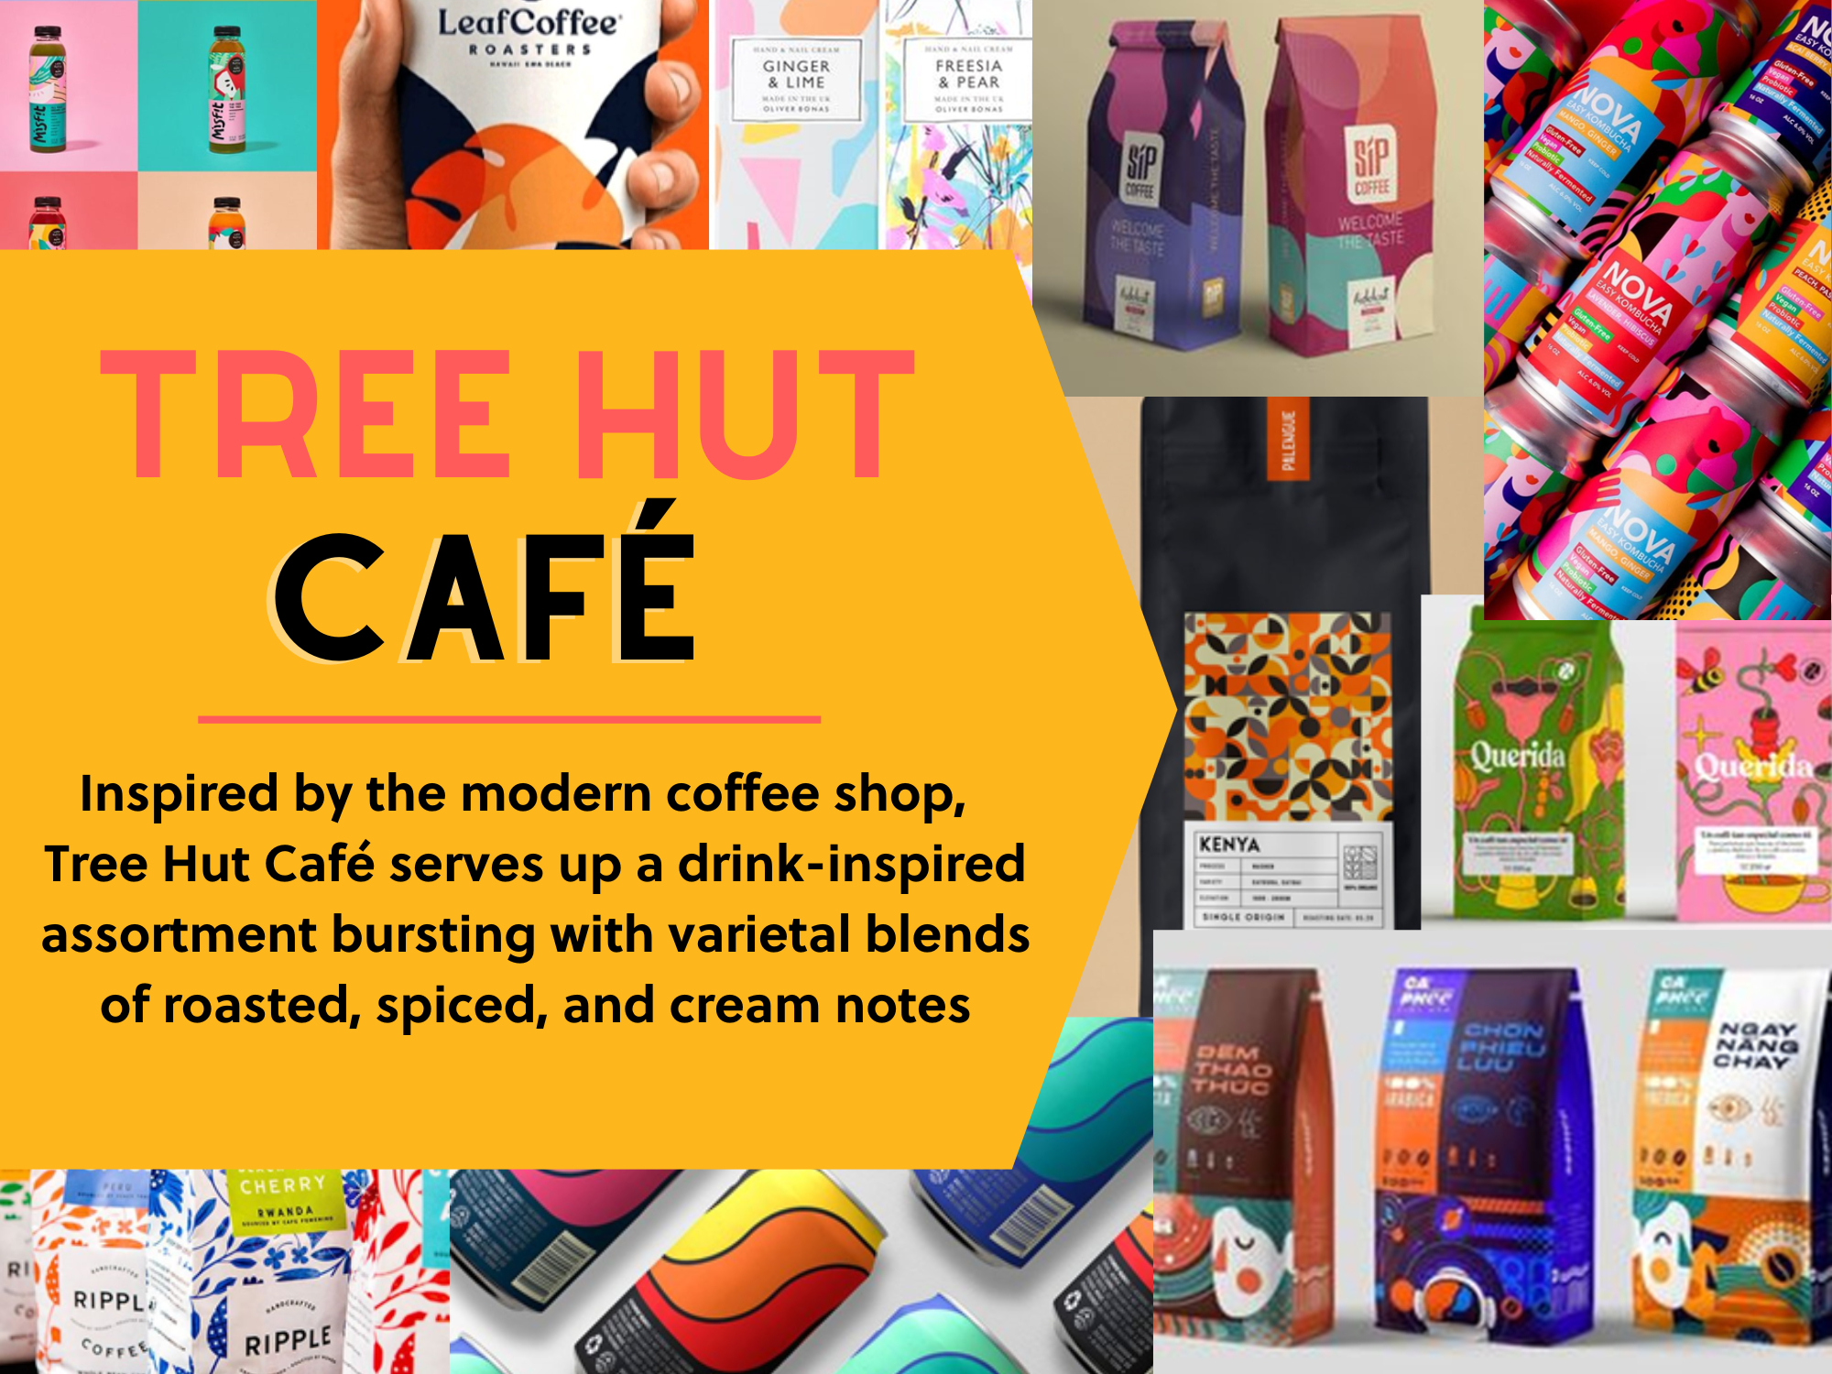

Slide 15
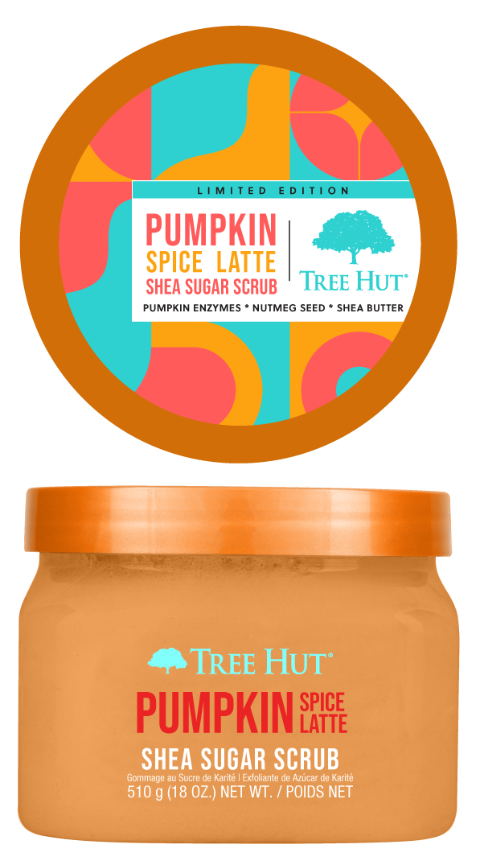
Shea Sugar Scrub: Fall Fragrance
≠≠≠
Pumpkin Spice Latte Sugar Scrub
Enjoy that fall feeling with seasonal notes of pumpkin, orange zest, cinnamon and nutmeg. Pumpkin enzymes and moisturizing shea butter leave skin feeling soft and smooth.
Benefits
PUMPKIN ENZYMES rich in vitamins A & E, known to help refine skin texture for super smooth skin
NUTMEG SEED OIL is a natural anti-inflammatory known to help reduce skin inflammation and help even out skin tone
SHEA BUTTER is known to deeply moisturize, nourish and soften skin while helping to promote elasticity.
Scent Profile
TOP:
Pumpkin, Orange Zest, Confectioner’s Sugar Glaze
MIDDLE:
Baked Scones, Nutmeg, Cinnamon
BOTTOM:
Vanilla, Butter, Clove
CONFIDENTIAL INFORMATION |

Slide 16
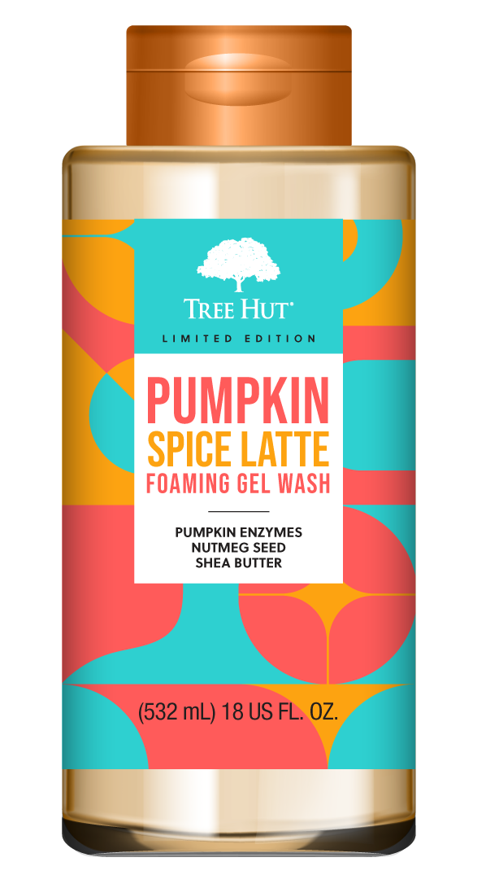
Body Wash: Fall Fragrance
≠≠≠
Pumpkin Spice Latte Body Wash
Lather your skin with the seasonal notes of pumpkin, orange zest, cinnamon and nutmeg. Pumpkin enzymes and moisturizing shea butter leave skin feeling refreshed and smooth.
Benefits
PUMPKIN ENZYMES rich in vitamins A & E, known to help refine skin texture for super smooth skin
NUTMEG SEED OIL is a natural anti-inflammatory known to help reduce skin inflammation and help even out skin tone
SHEA BUTTER is known to deeply moisturize, nourish and soften skin while helping to promote elasticity.
Scent Profile
TOP:
Pumpkin, Orange Zest, Confectioner’s Sugar Glaze
MIDDLE:
Baked Scones, Nutmeg, Cinnamon
BOTTOM:
Vanilla, Butter, Clove
CONFIDENTIAL INFORMATION |

Slide 17
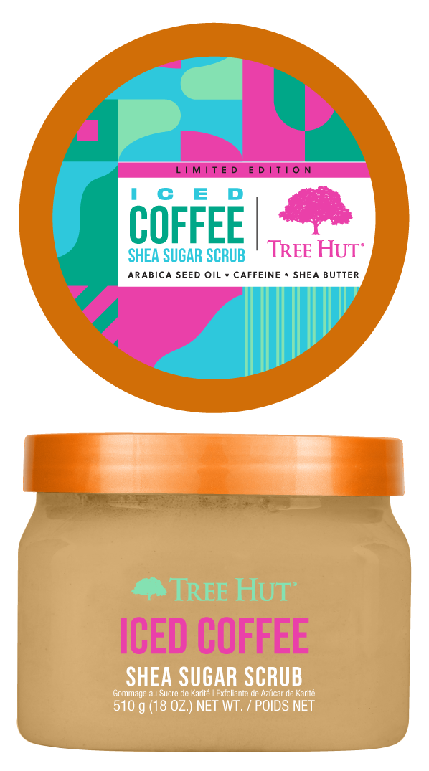

Shea Sugar Scrub: Fall Fragrance
≠≠≠
Iced Coffee Sugar Scrub
Awaken and restore dull skin with Arabica Coffee Seed Oil and Caffeine. Wrap yourself in rich notes of coffee, hazelnut, and chocolate for an indulgent experience
Benefits
COFFEE ARABICA SEED POWDER restores dull skin and promotes skin moisture retention for a glow that lasts all day.
CAFFEINE helps reduce skin inflammation and is known to firm and tighten skin.
SHEA BUTTER is known to deeply moisturize, nourish and soften skin while helping to promote elasticity.
Scent Profile
TOP:
Coffee,
Maple
MIDDLE:
Hazelnut,
Creamy Marshmallow
BOTTOM:
Chocolate,
Vanilla
700412
CONFIDENTIAL INFORMATION |

Slide 18
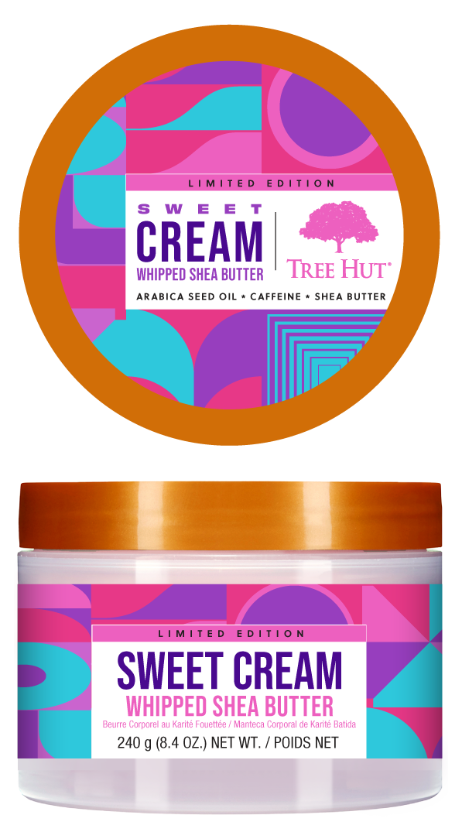

Whipped Butter: Fall Fragrance
≠≠≠
Sweet Cream Whipped Butter
Envelop skin in creamy comfort with notes of honey, coconut cream and marshmallow. Formulated with vanilla fruit and colloidal oat to protect and moisturize your skin barrier, your skin will thank you for this cozy, cushiony whipped butter.
Benefits
VANILLA FRUIT has stimulating, soothing, calming, anti-microbial and antioxidant properties
COLLOIDAL OAT can help protect and moisturize sensitive skin, with compounds beneficial for the barrier function and hydration
SHEA BUTTER is known to deeply moisturize, nourish and soften skin while helping to promote elasticity.
Scent Profile
TOP:
Almond Butter, Honey
MIDDLE:
Coconut Cream, Marshmallow Fluff
BOTTOM:
Vanilla Bean, Caramel
701522
CONFIDENTIAL INFORMATION |

Slide 19
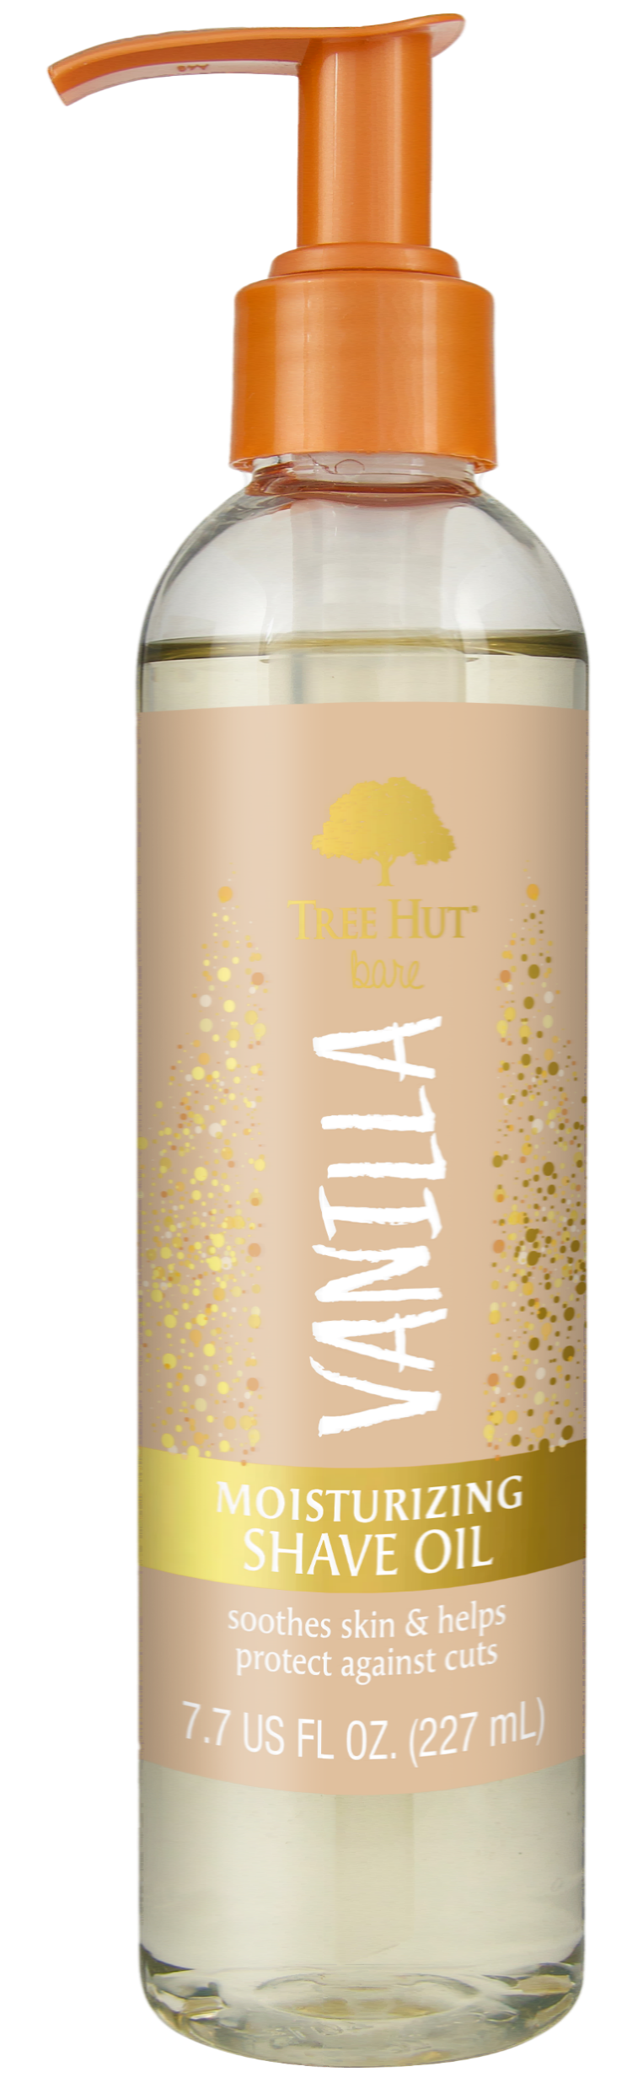

Shave Oil
≠≠≠
Vanilla Shave Oil
Shimmer and shine with Tree Hut’s Vanilla Body Oil.
Packed with real vanilla extract to soothe skin, this shave oil will have you glowing from head to toe
Benefits
VANILLA FRUIT has stimulating, soothing, calming, anti-microbial and antioxidant properties
COLLOIDAL GOLD known to increase skin elasticity and plump skin. Its small size allows gold to penetrate skin effectively for a lifting effect.
SHEA BUTTER is known to deeply moisturize, nourish and soften skin while helping to promote elasticity.
Scent Profile
TOP:
Sheer Jasmine
MIDDLE:
Coconut Cream
BOTTOM:
Vanilla, Musk Sandalwood
702816
CONFIDENTIAL INFORMATION |

Slide 20


Slide 21
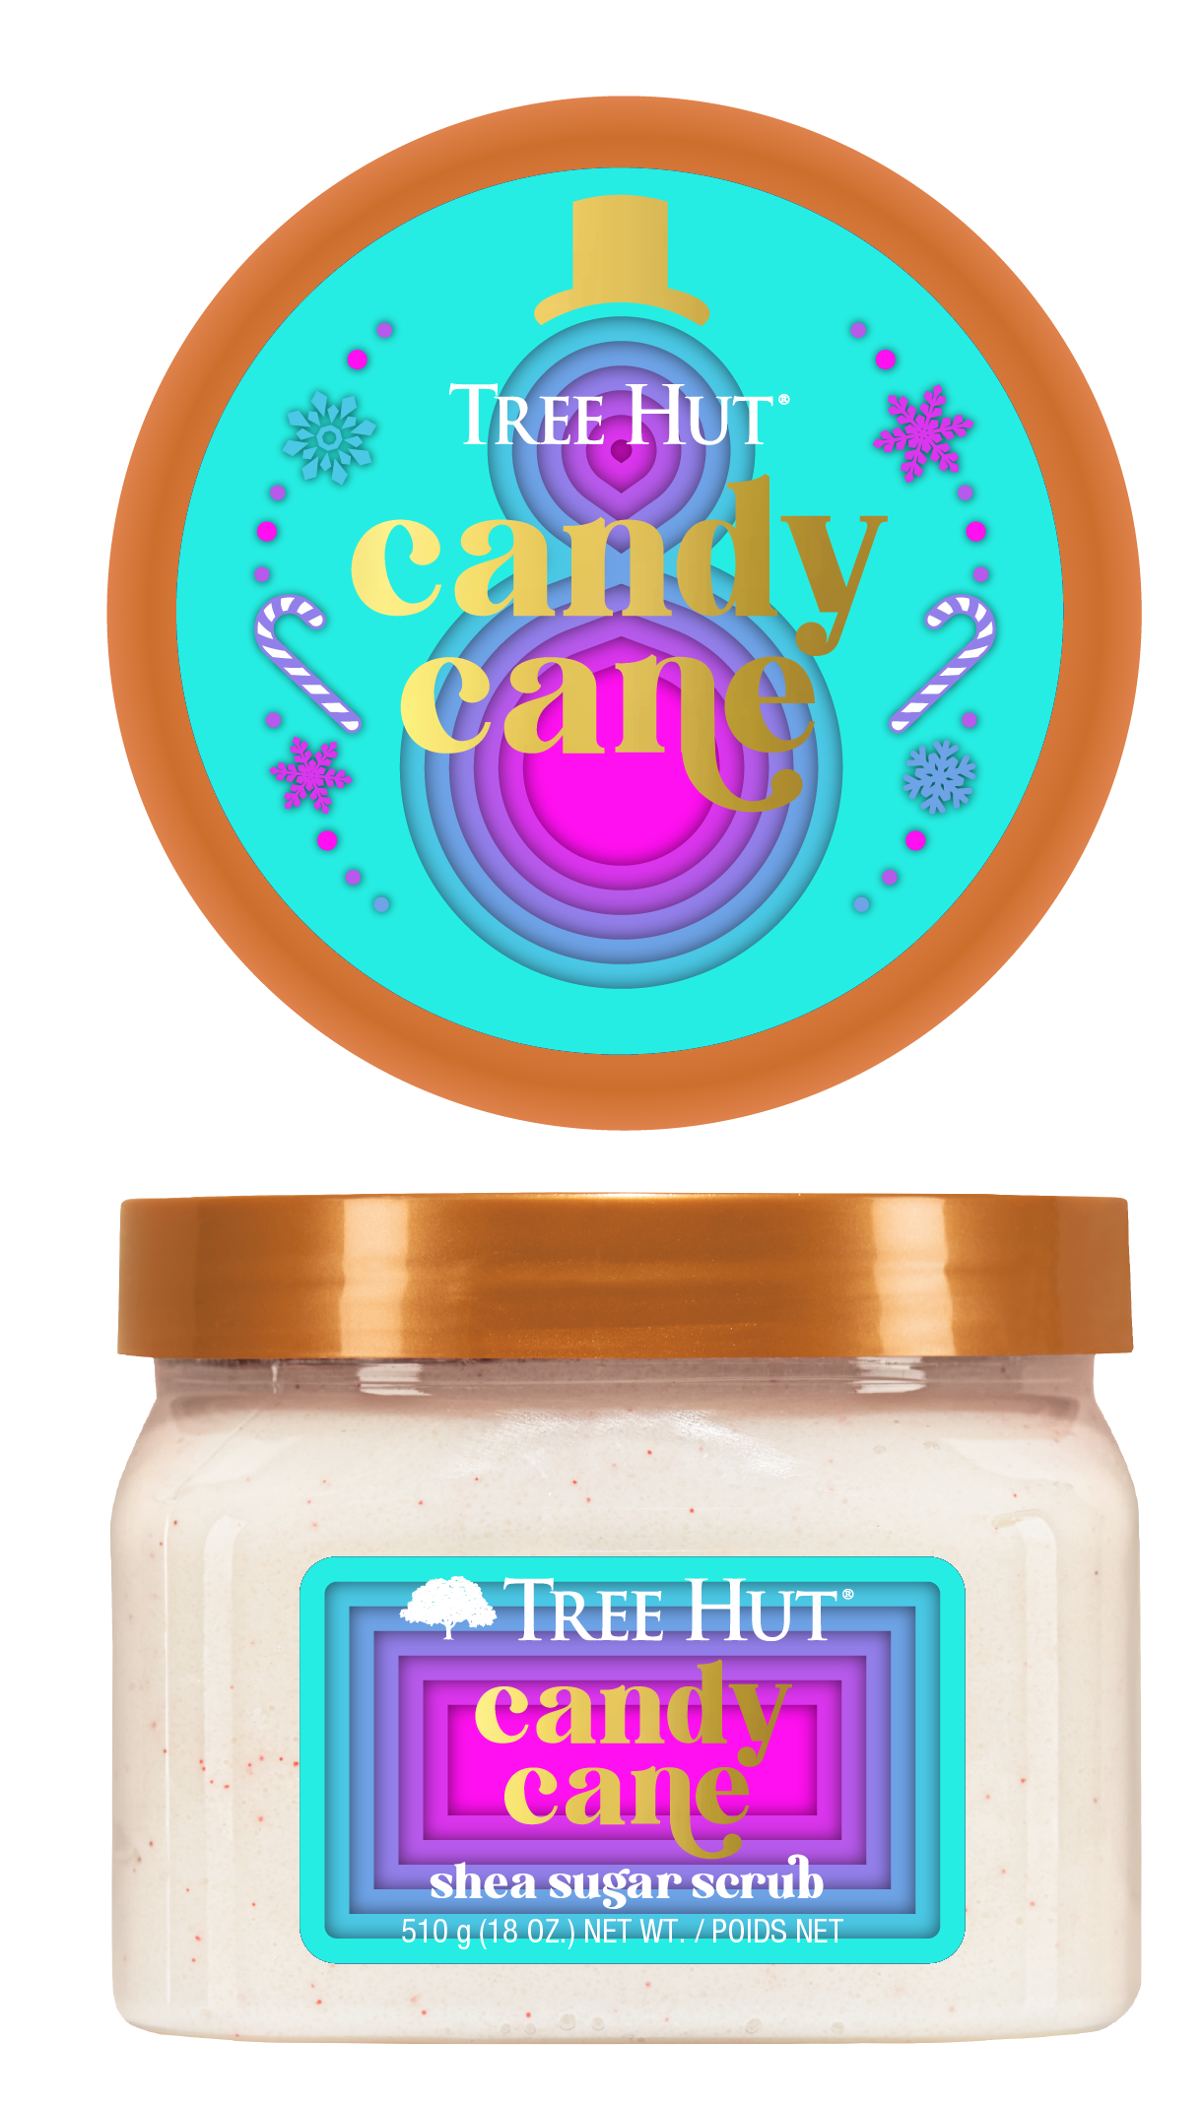

Shea Sugar Scrub: Holiday
≠≠≠
Candy Cane Sugar Scrub
Tis' the season to soothe dry winter skin. Packed with nourishing antioxidants, shea butter and vanilla, Candy Cane Sugar Scrub is a festive way to get a holiday glow.
Benefits
VANILLA BEAN rich in antioxidants and vitamin B, vanilla can protect your skin from environmental pollutants and soothe dry skin.
PEPPERMINT OIL a natural anti-bacterial, peppermint oil soothes irritated skin and reduces inflammation.
SHEA BUTTER is known to deeply moisturize, nourish and soften skin while helping to promote elasticity.
Scent Profile
TOP:
Fruity, Anise, Peppermint
MIDDLE:
Strawberry, Cotton Candy
BOTTOM:
Vanilla, Caramel
700374
CONFIDENTIAL INFORMATION |

Slide 22
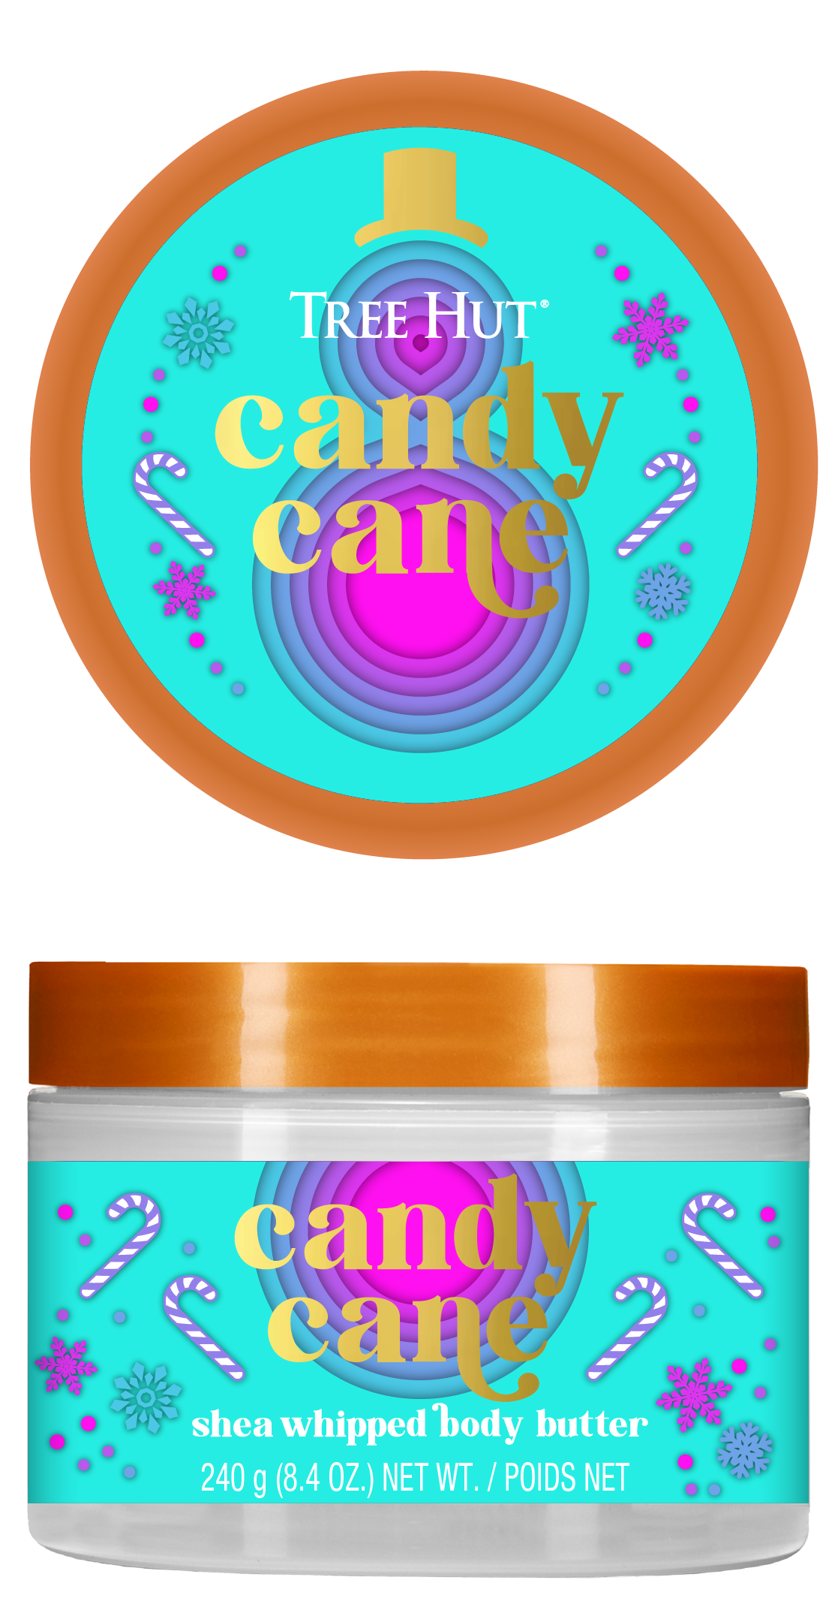

Whipped Butter: Holiday
≠≠≠
Candy Cane Whipped Butter
Give dry winter skin a reason to glow this season! Our lightweight formula packs a hydration punch with nourishing antioxidants, shea butter and vanilla. Candy Cane Whipped Butter is a festive way to get a holiday glow.
Benefits
VANILLA BEAN rich in antioxidants and vitamin B, vanilla can protect your skin from environmental pollutants and soothe dry skin.
PEPPERMINT OIL a natural anti bacterial, peppermint oil soothes irritated skin and reduces inflammation.
SHEA BUTTER is known to deeply moisturize, nourish and soften skin while helping to promote elasticity.
Scent Profile
TOP:
Fruity, Anise, Peppermint
MIDDLE:
Strawberry, Cotton Candy
BOTTOM:
Vanilla, Caramel
700767
CONFIDENTIAL INFORMATION |

Slide 23
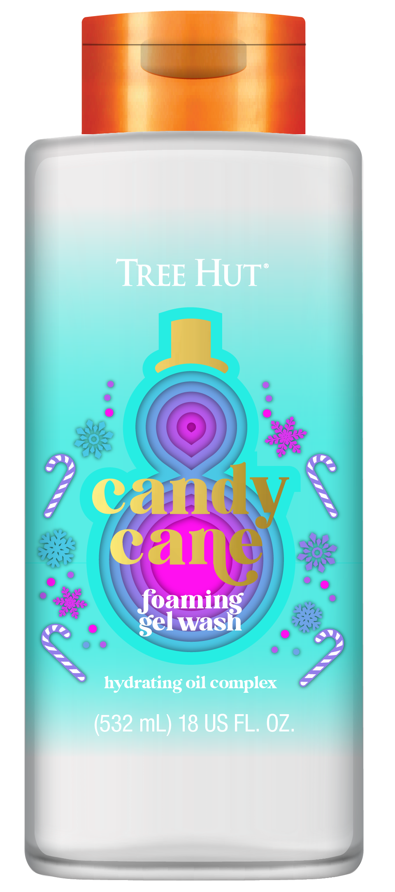

Body Wash: Holiday
≠≠≠
Candy Cane Body Wash
Get ready to sing this holidays when you shower with our Candy Cane Foaming Gel Wash! Enjoy a rich lather packed with nourishing antioxidants, shea butter and vanilla. Candy Cane Body Wash is a festive way to get a holiday glow.
Benefits
VANILLA BEAN rich in antioxidants and vitamin B, vanilla can protect your skin from environmental pollutants and soothe dry skin.
PEPPERMINT OIL a natural anti bacterial, peppermint oil soothes irritated skin and reduces inflammation.
SHEA BUTTER is known to deeply moisturize, nourish and soften skin while helping to promote elasticity.
Scent Profile
TOP:
Fruity, Anise, Peppermint
MIDDLE:
Strawberry, Cotton Candy
BOTTOM:
Vanilla, Caramel
700603
CONFIDENTIAL INFORMATION |

Slide 24
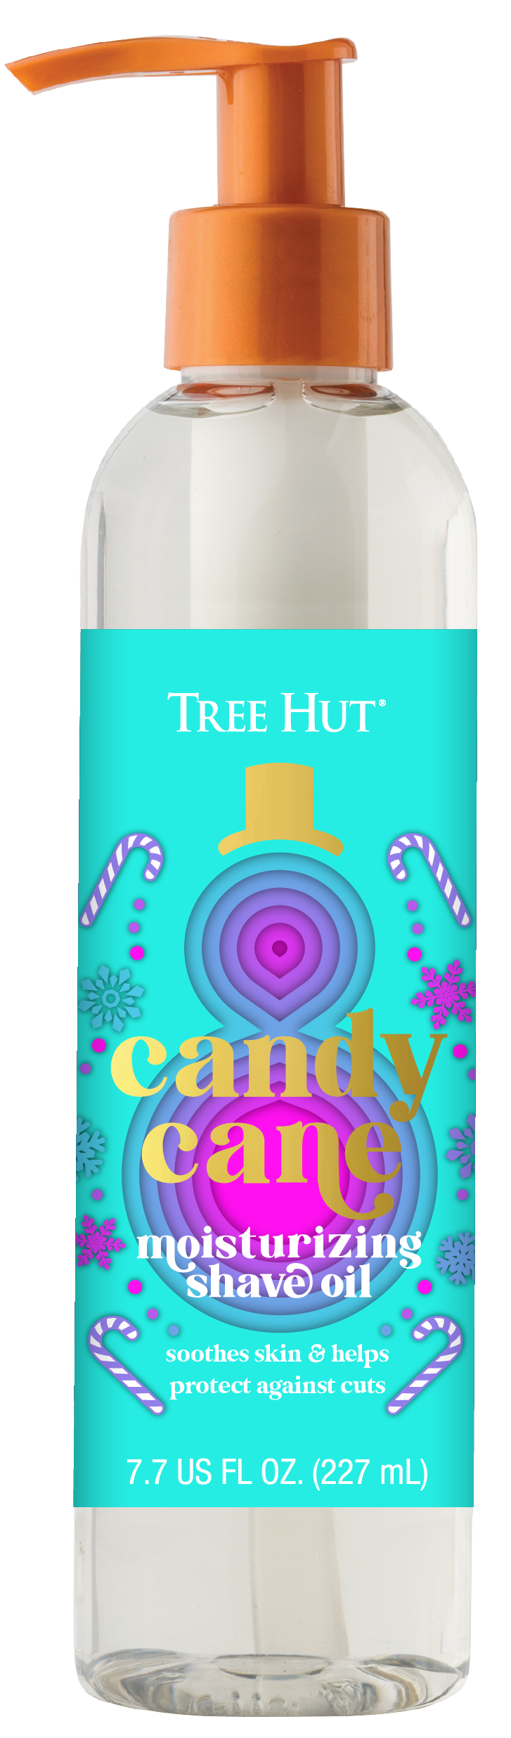
Shave Oil: Holiday
≠≠≠
Candy Cane Shave Oil
Get a silky-smooth, sweet skin when you shave with our Candy Cane Moisturizing Shave Oil with soothing peppermint, shea butter, and vanilla.
Candy Cane Shave Oil is a festive way to get a holiday glow.
Benefits
VANILLA BEAN rich in antioxidants and vitamin B, vanilla can protect your skin from environmental pollutants and soothe dry skin.
PEPPERMINT OIL a natural anti bacterial, peppermint oil soothes irritated skin and reduces inflammation.
SHEA BUTTER is known to deeply moisturize, nourish and soften skin while helping to promote elasticity.
Scent Profile
TOP:
Fruity, Anise, Peppermint
MIDDLE:
Strawberry, Cotton Candy
BOTTOM:
Vanilla, Caramel
TBD
CONFIDENTIAL INFORMATION |

